Slide 1

DAYANANDA SAGAR COLLEGE OF ENGINEERING Shavige Malleshwara Hills, Kumaraswamy Layout, Bangalore-560078 (An Autonomous Institute affiliated to VTU, Approved by AICTE &ISO 9001: 2008 Certified) Accredited by National Assessment & Accreditation Council (NAAC) with ‘A’ Grade Department of Mechanical Engineering
Batch
Number
48
Final Year Project - Phase II Presentation
Autonomous Precision Landing of Model Rockets
Guide Name | Sanketh S
Designation | Asst. Professor
Student Name | Raghavendra N S | Sohail Nadaf | Tushar V Kulkarni | Vivek S Srinivas
USN | 1DS17ME093 | 1DS17ME124 | 1DS17ME131 | 1DS17ME145

Slide 2
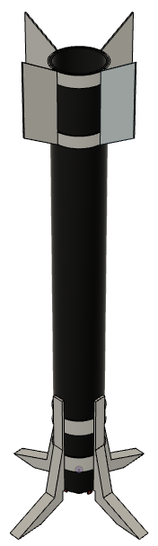
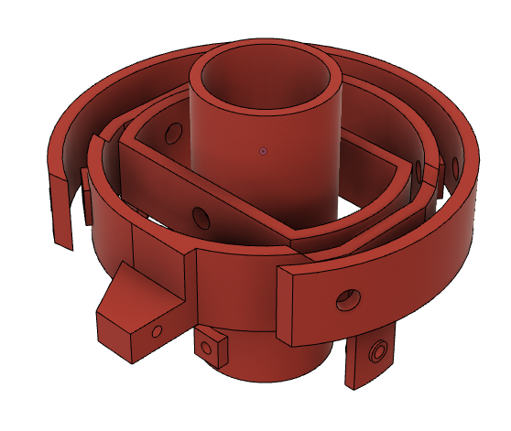
Passive fins for stability
DESIGN
Ignite the motor
PROJECT
OVERVIEW
Reduce velocity at a
steady rate
OPTIMIZE
MODELING & SIMULATION
Thrust vector control for
Attitude correction
Near zero velocity
close to ground
Deploy landing legs
DESIGN
Landing the rocket vertically

Slide 3
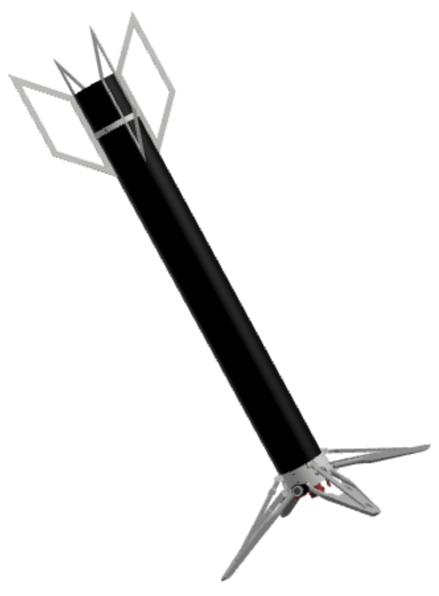
Objectives of the Project
Building an aerodynamic rocket body and fins to achieve maximum passive stability
Developing a Thrust Vector Control (TVC) system for active attitude control
Integrating a flight computer for data logging and various other operations
Developing landing legs to withstand the impact and ensuring the safety of components
Modelling and simulation of rocket dynamics using MATLAB & Simulink
Testing and validation of designed components

Slide 4
Literature Survey
M. Haw, “A8-3 Model rocket impulse measurement,” Science One Research Projects (Undergraduate Science Program), University of British Columbia, British Columbia, Canada, May 2009.
R. Ferrante, “A Robust Control Approach for Rocket Landing,” M.S. thesis, Artificial Intelligence, School of Informatics, University of Edinburgh, Scotland, 2017.
L. Blackmore, ”Autonomous precision landing of space rockets,” Frontiers of Engineering: Reports on Leading-Edge Engineering from the Symposium 2016.
F. Kehl, A. M. Mehta, K. S. J. Pister, “An Attitude Controller for Small Scale Rockets,” Springer Tracts in Advanced Robotics, Jan 2015.
Penn, Kim & Slaton, William, “Measuring Model Rocket Engine Thrust Curves,” The Physics Teacher, 2010.

Slide 5
Methodology: Design Phase
Thrust Vector Control (TVC)
Mount Design
Control Algorithm
Recalibrate PID
Flight Computer
Motor Ignition
TVC
Landing Leg Deployment
Objectives
Sizing of the Rocket
Modelling
Passive Fins
Design
Requirements
Kinematics
Dynamics
Trajectory
Rocket Body
Design
Landing Legs
Design
Iterative Process
Simulation

Slide 6
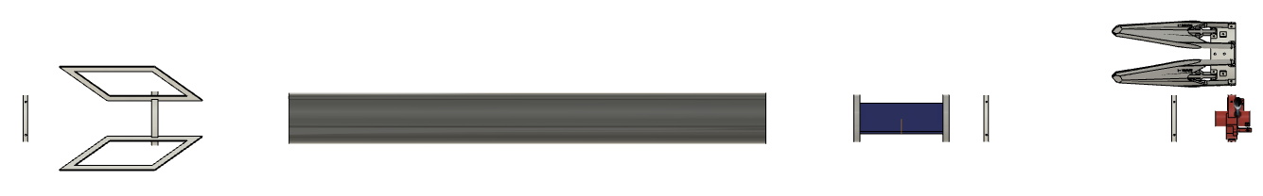
Rocket’s Exploded View
Fins
Flight
Computer
Firewall
Airframe
Bulkhead
Bulkhead
TVC
Landing
Legs

Slide 7
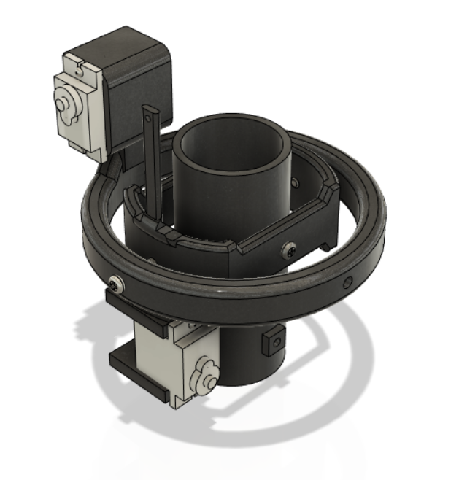
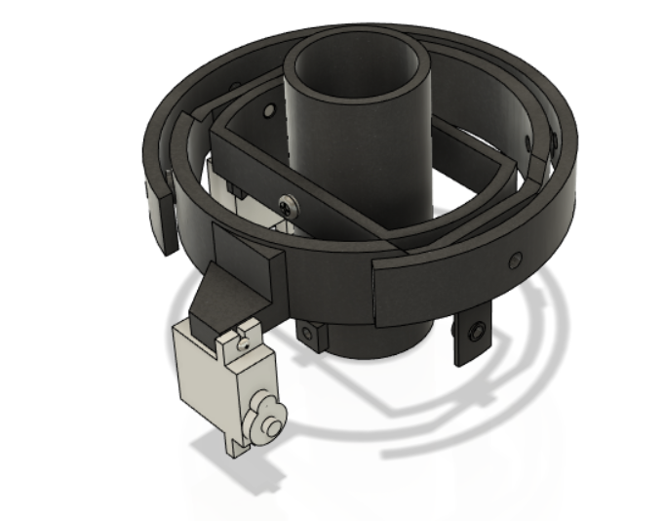
Thrust Vector Control

Slide 8
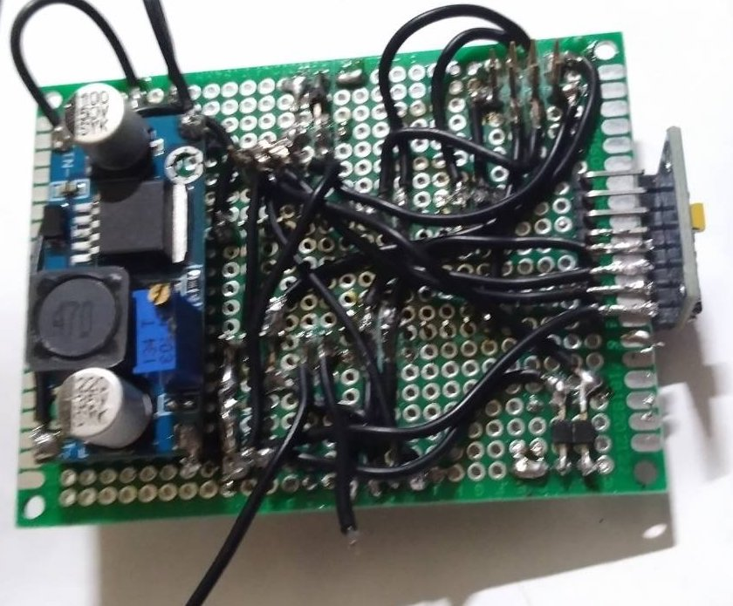
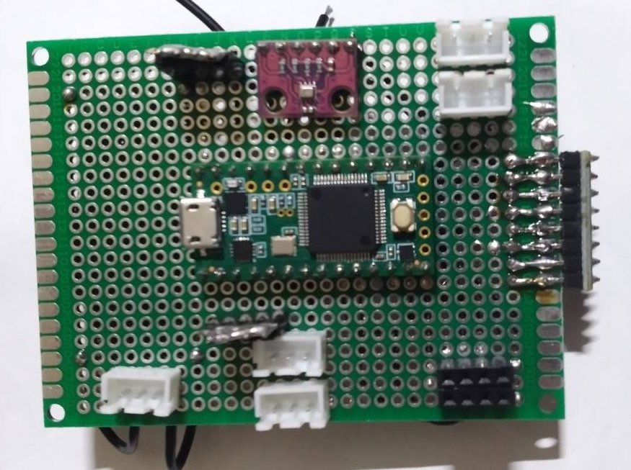
Flight Computer

Slide 9
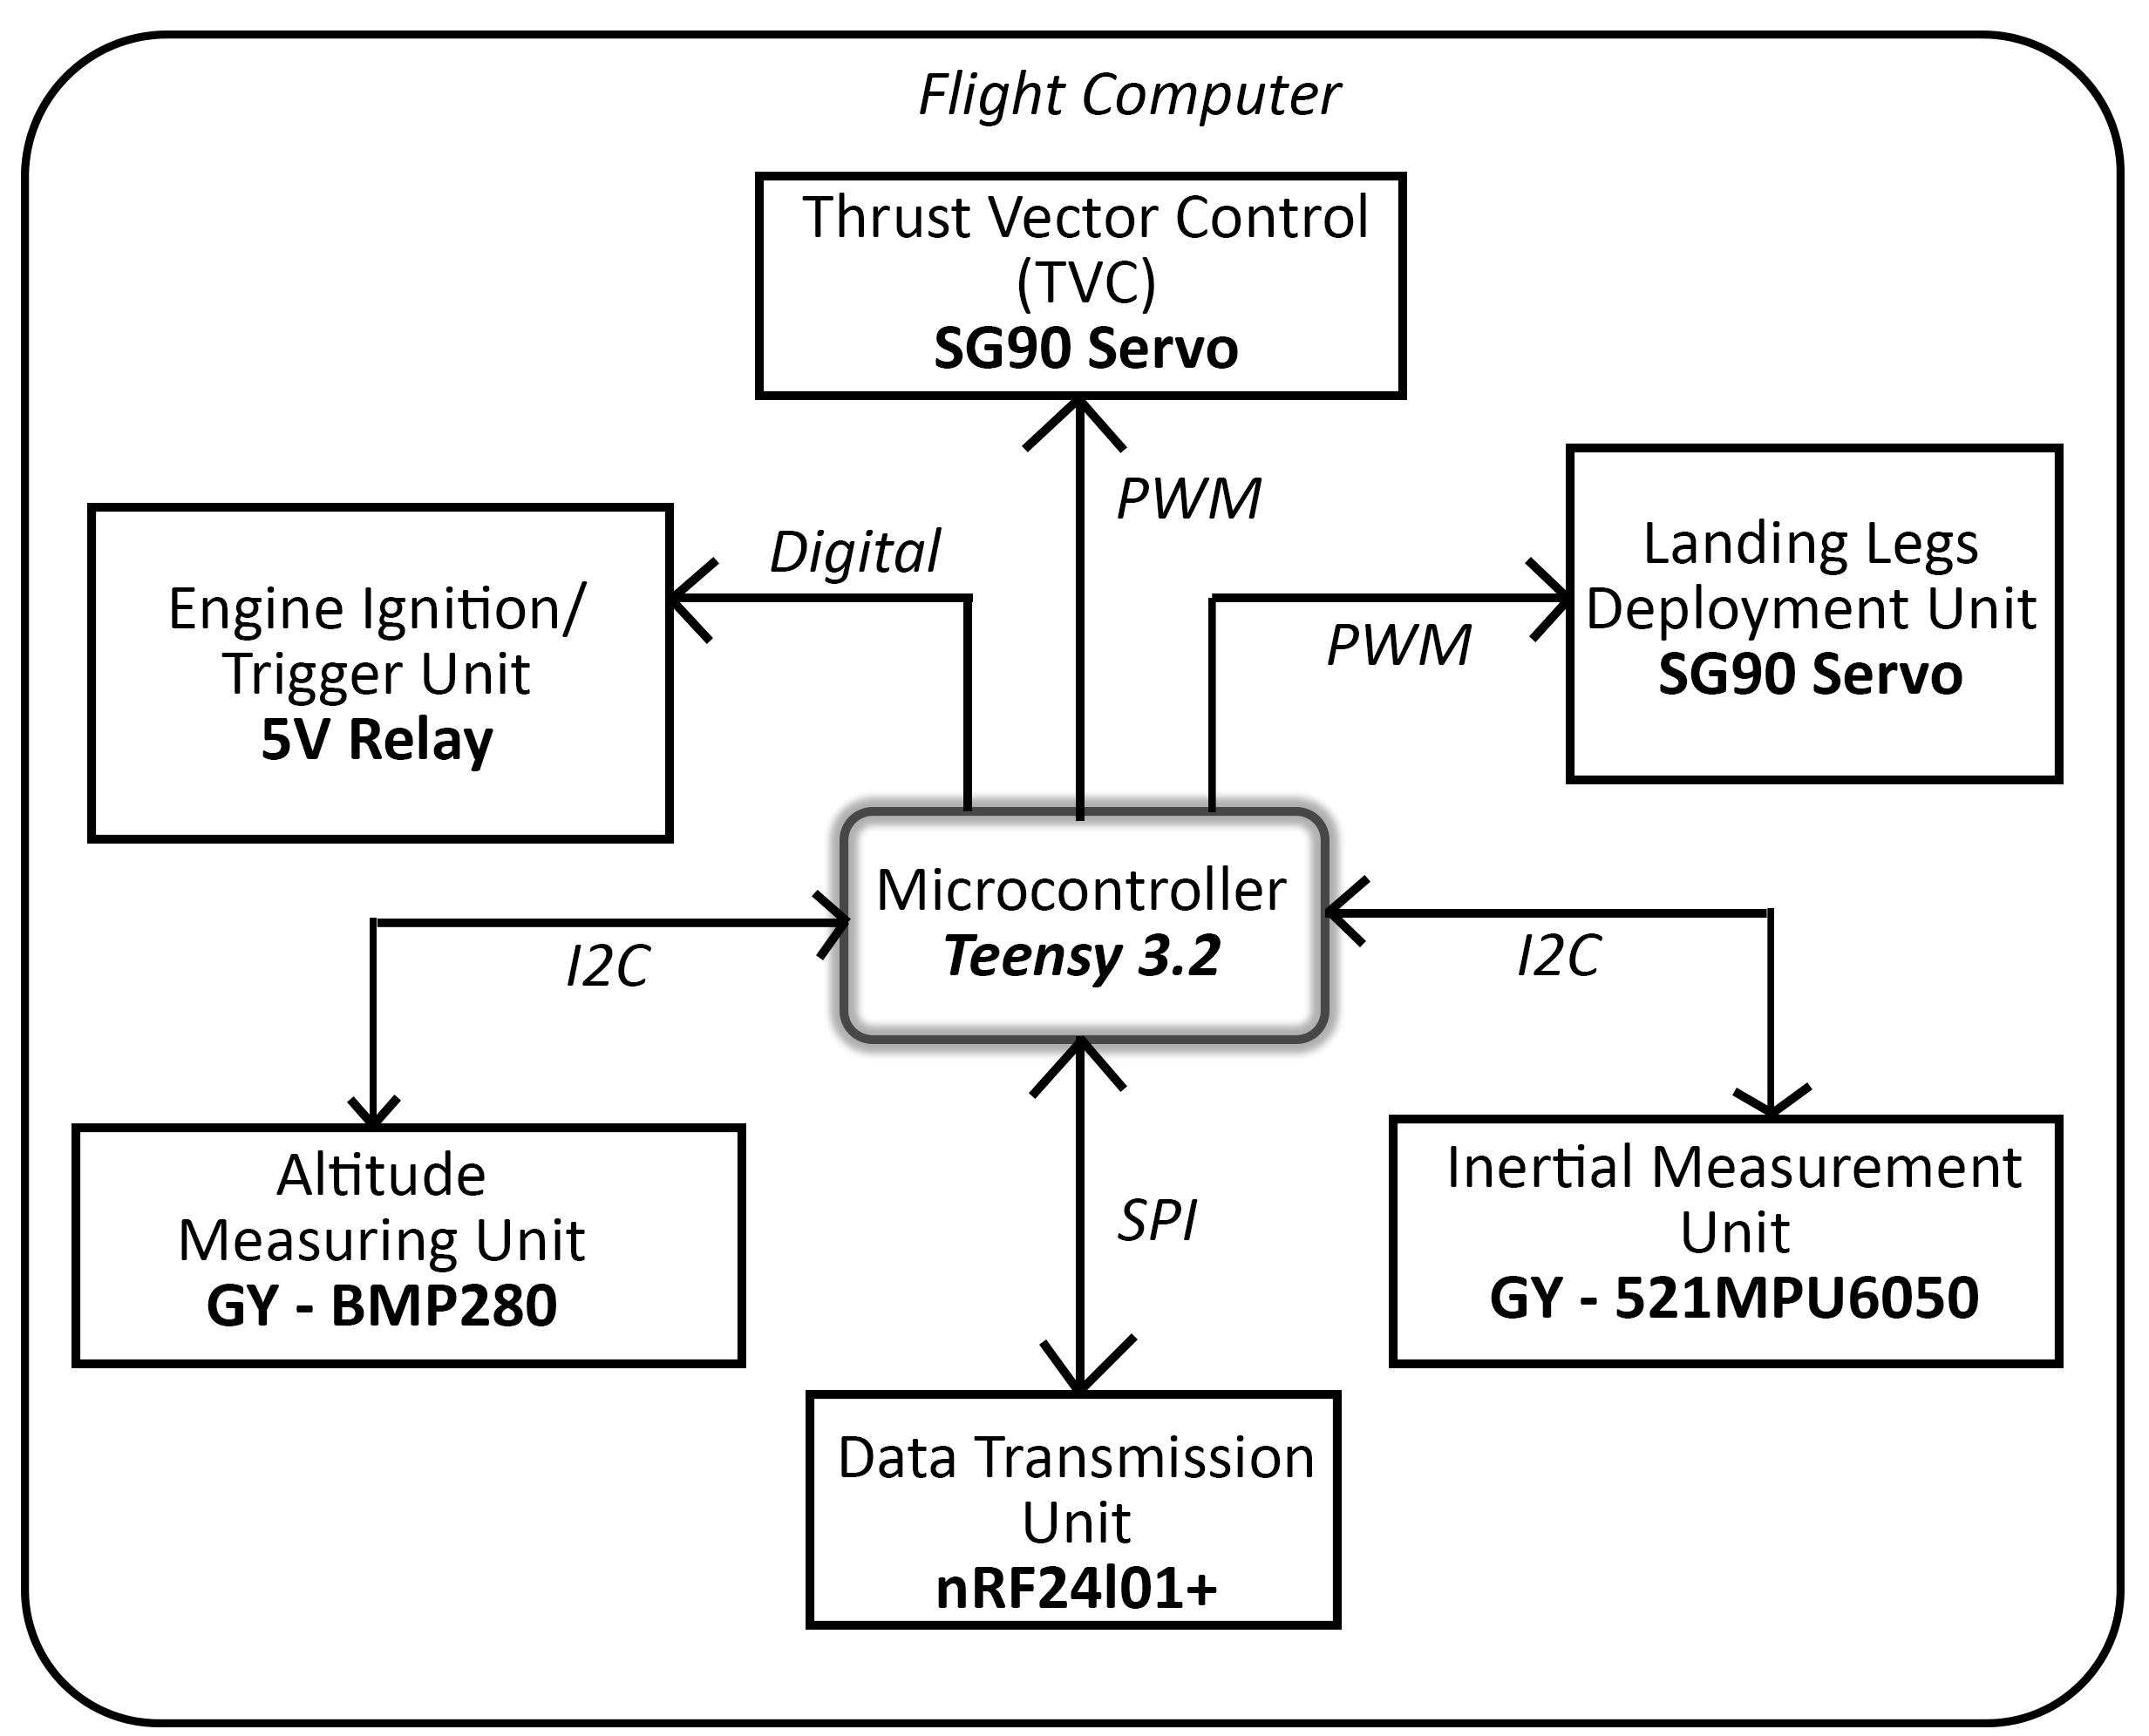
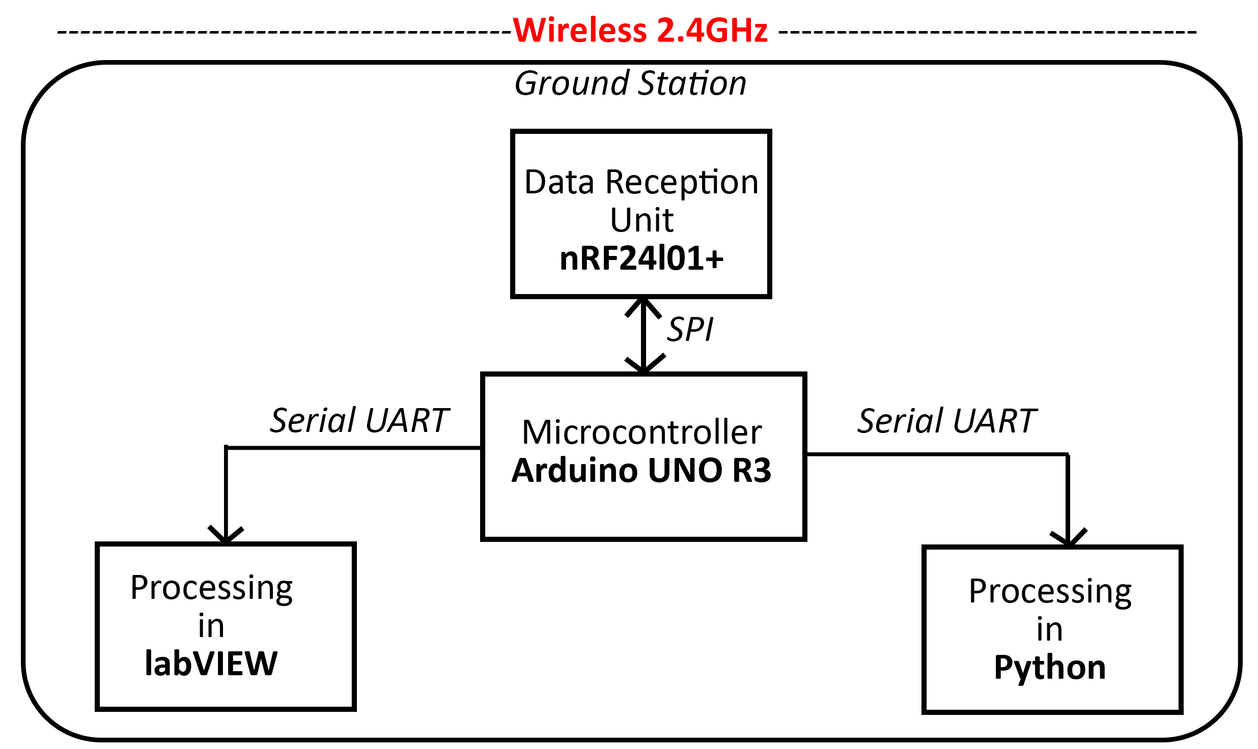
Block Diagram

Slide 10
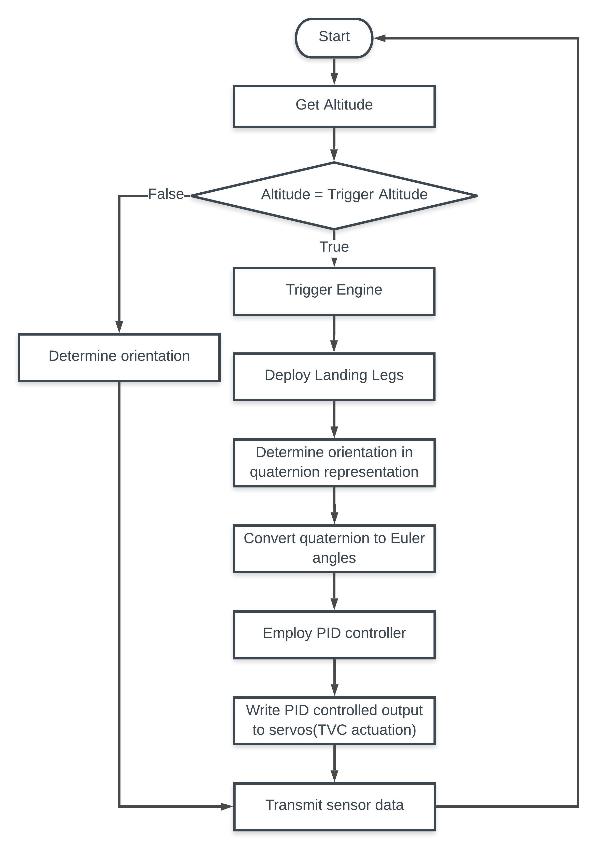
Flow Chart

Slide 11
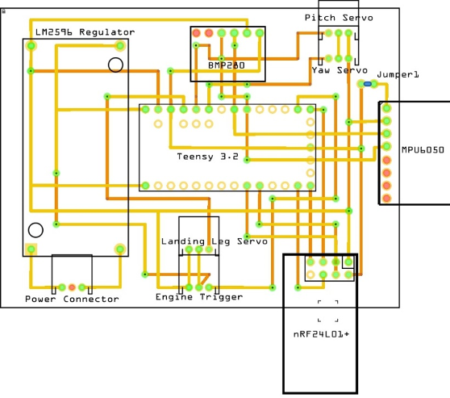
PCB Schematic

Slide 12
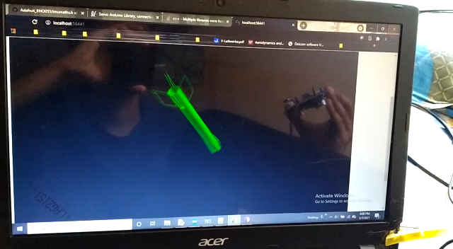
Processing in Python

Slide 13
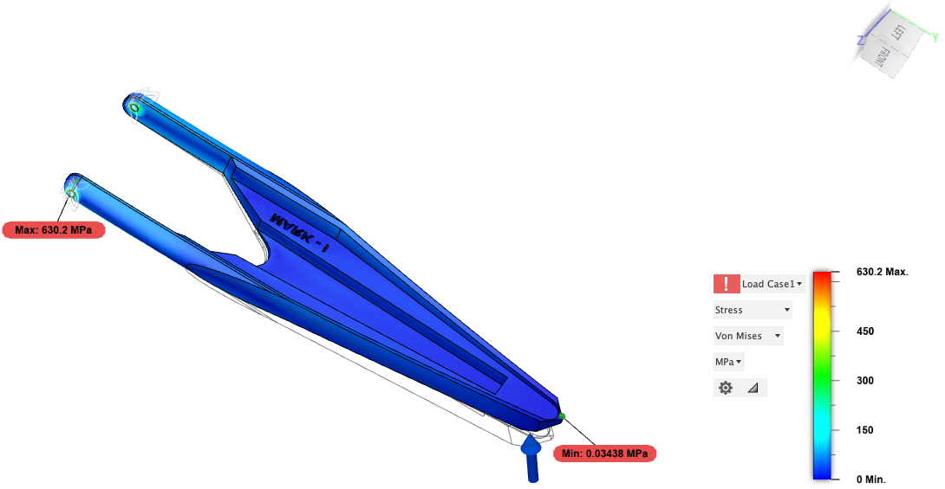
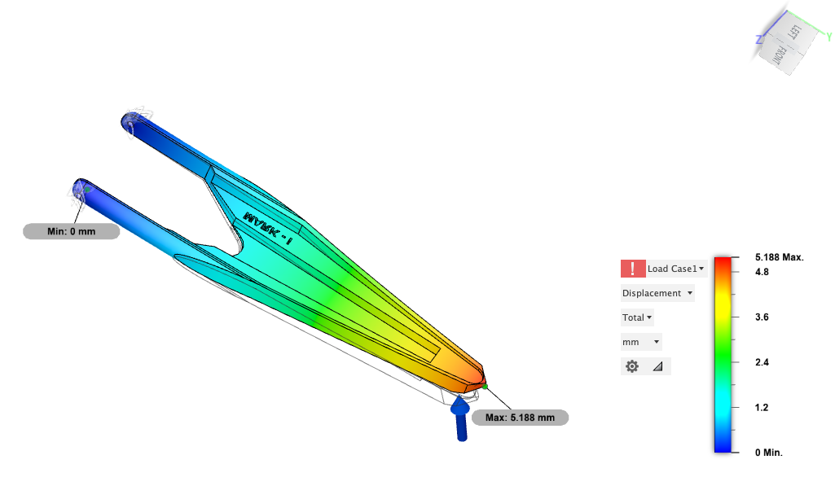
Static Structural Analysis – Landing Leg
Applied Force – 50N
Maximum Stress – 630.2MPa
Maximum Displacement – 5.18mm
Fixed Point
Contact Force

Slide 14
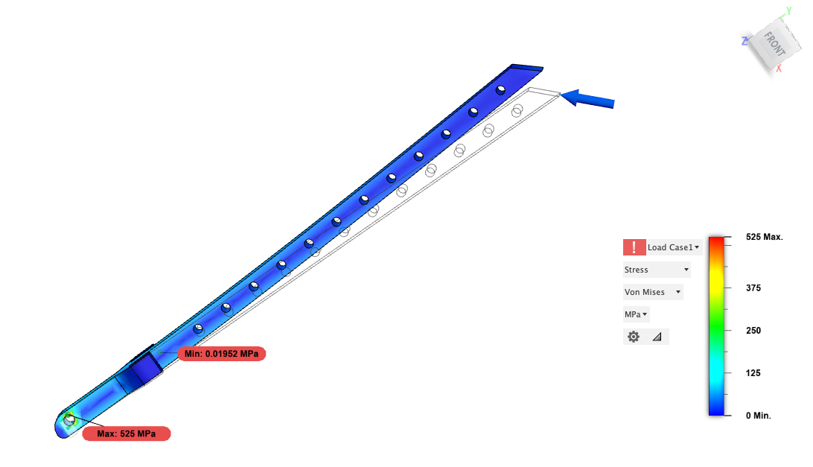
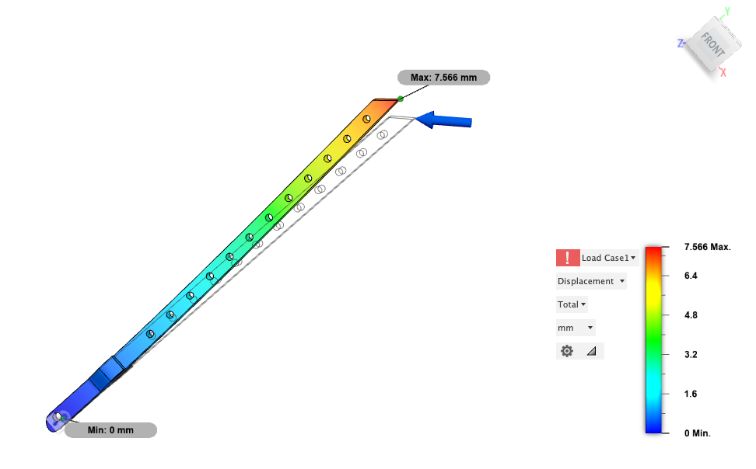
Static Structural Analysis – Landing Leg Strut
Applied Force – 50N
Maximum Stress – 525MPa
Maximum Displacement – 7.56mm
Fixed Point
Contact Force

Slide 15
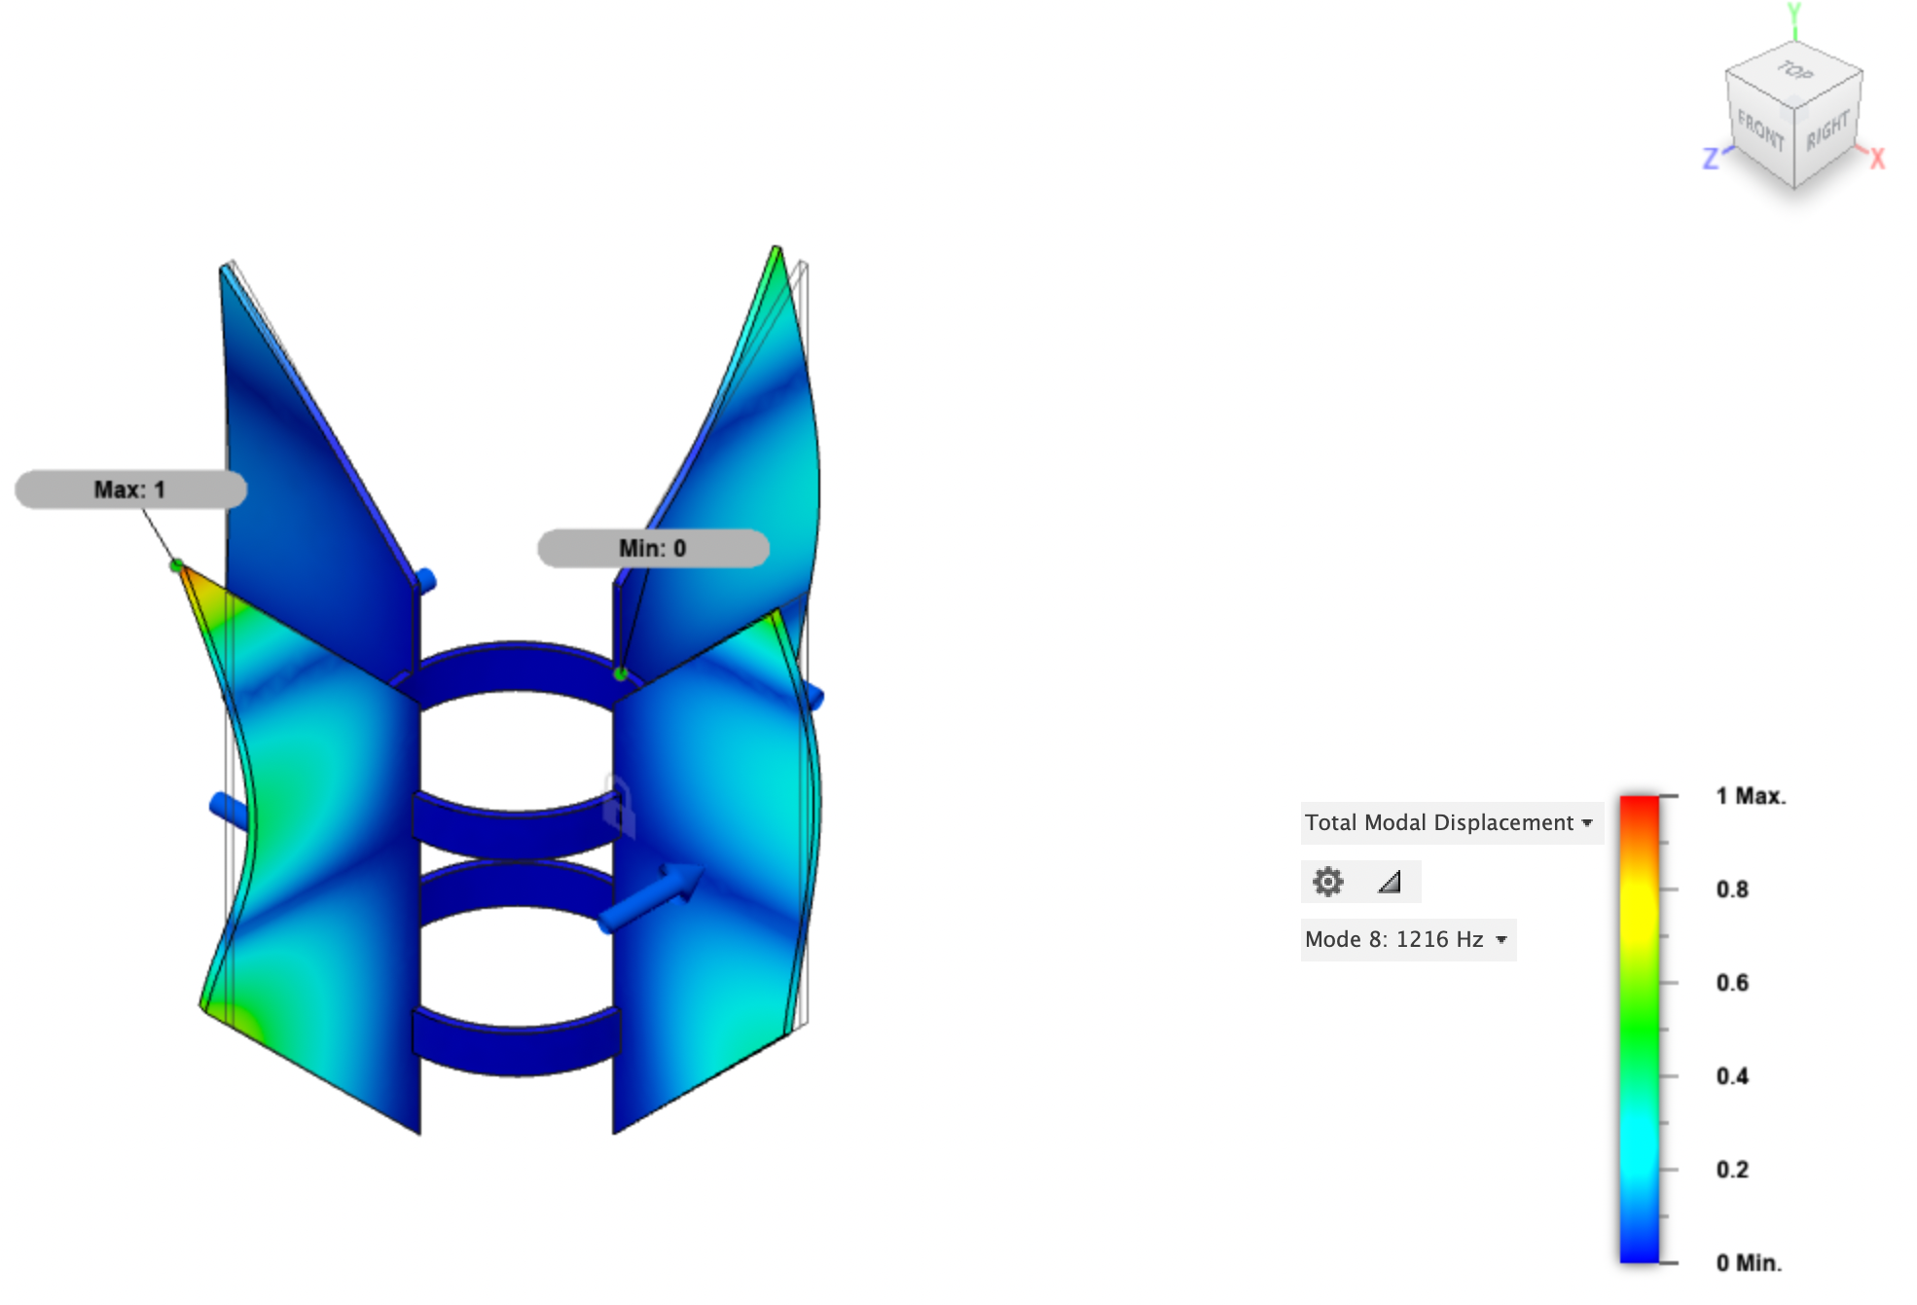
Modal Frequency Analysis - Fins
Natural Frequency – 1216Hz

Slide 16
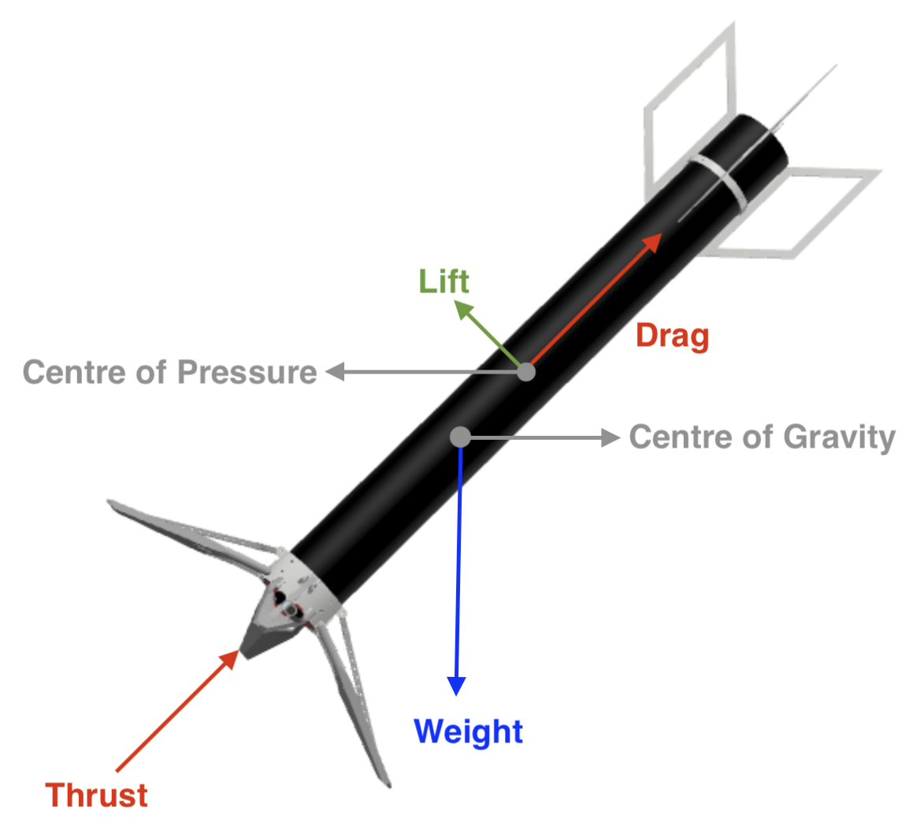
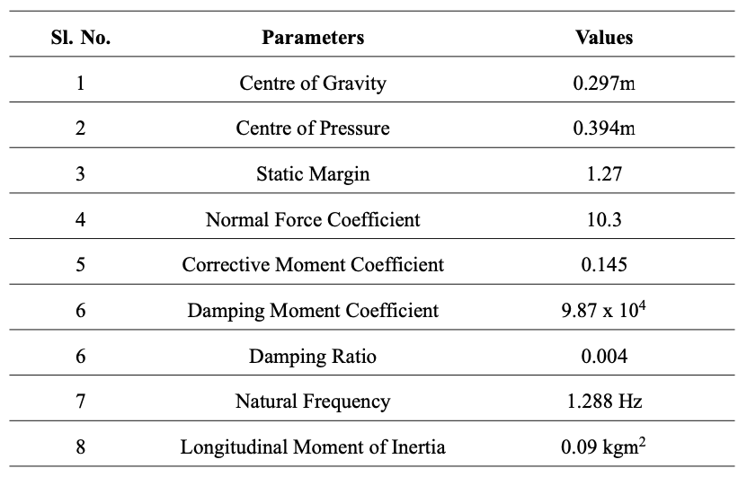
Dynamic Flight Analysis

Slide 17
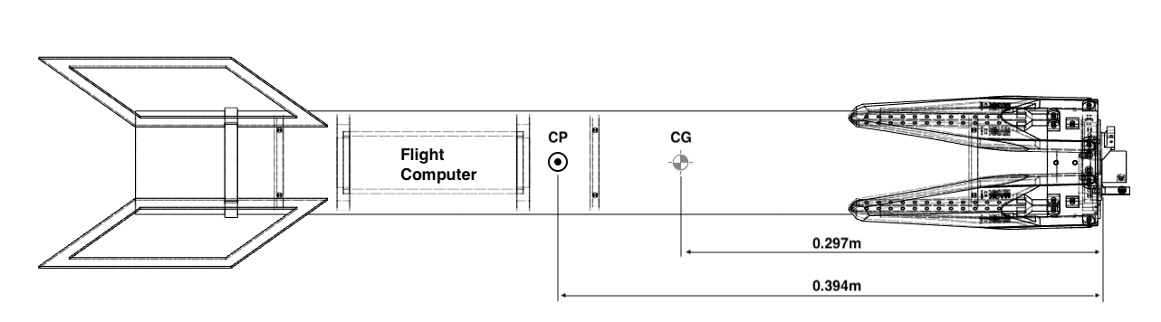
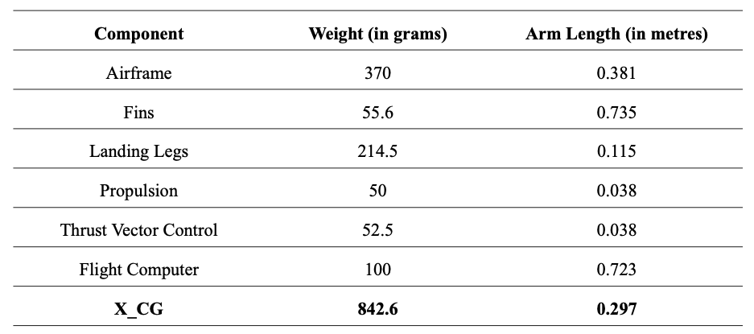
Stability Characteristics

Slide 18
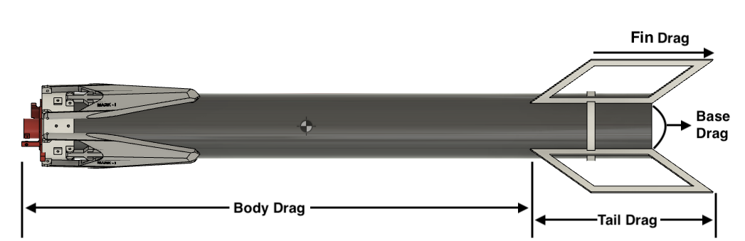
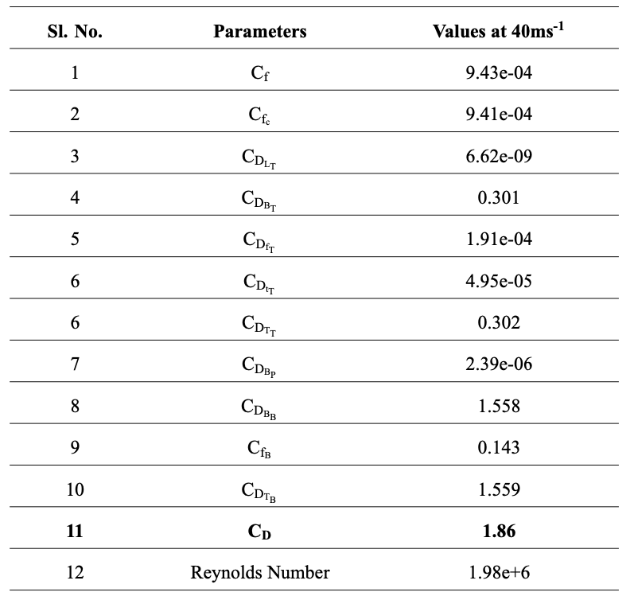
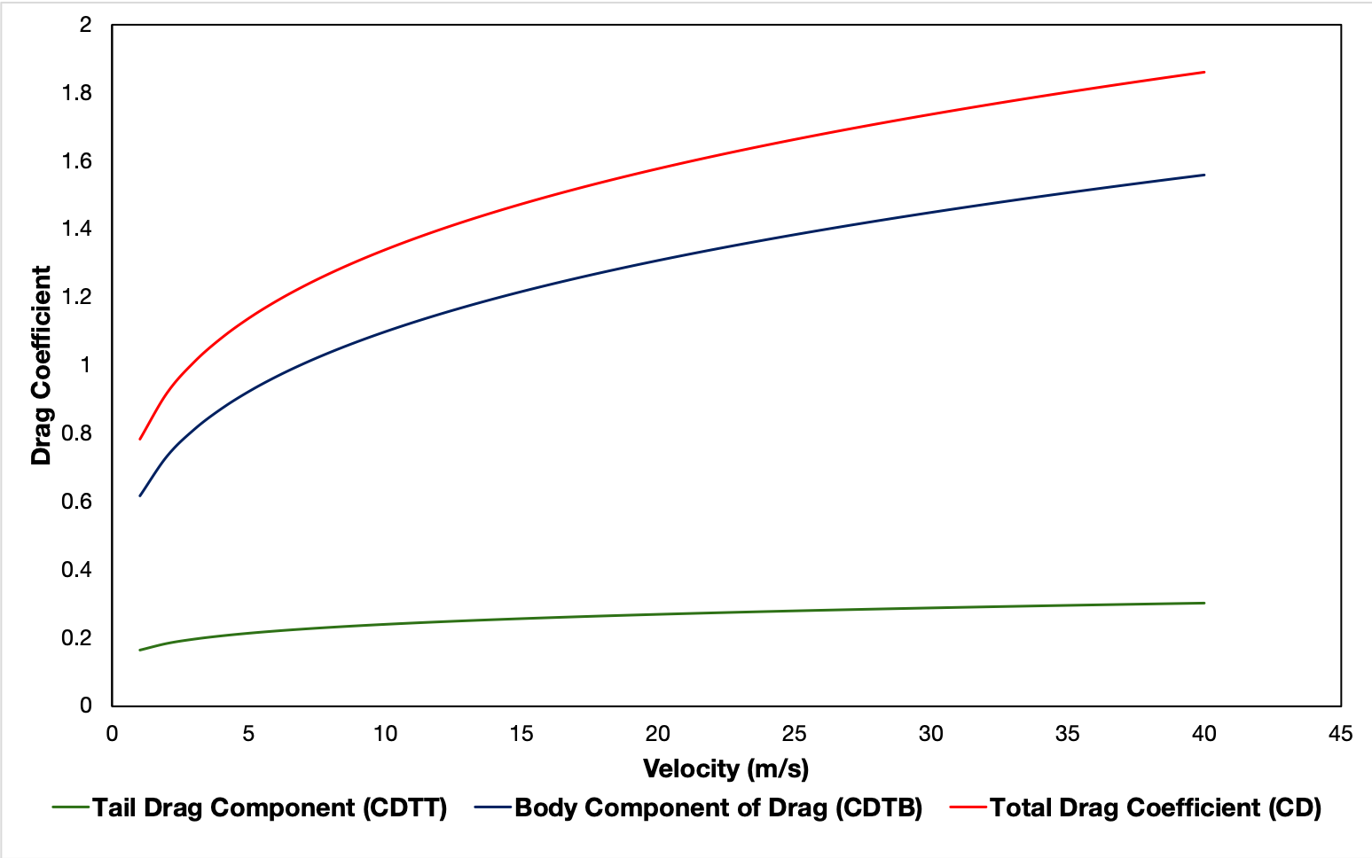
Aerodynamic Drag Analysis

Slide 19
CFD - OpenFOAM
Preprocessing
Solver
Postprocessing
blockMesh – Domain Definition
snappyHexMesh – 3D Model Definition
Incompressible Flow
simpleFoam
potentialFoam
paraFOAM
ParaView
Transient Flow Analysis
Turbulent Model – Reynolds-Averaged Navier Stokes Equation (RANS)
Approximation – Irrotational Flow
Analyzed at v = 40m/s

Slide 20
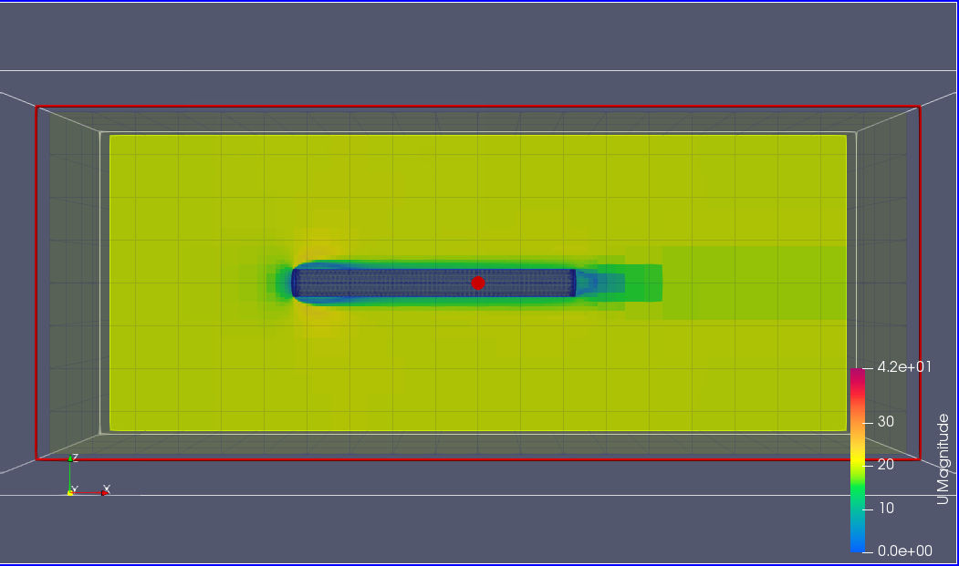
Velocity Field

Slide 21
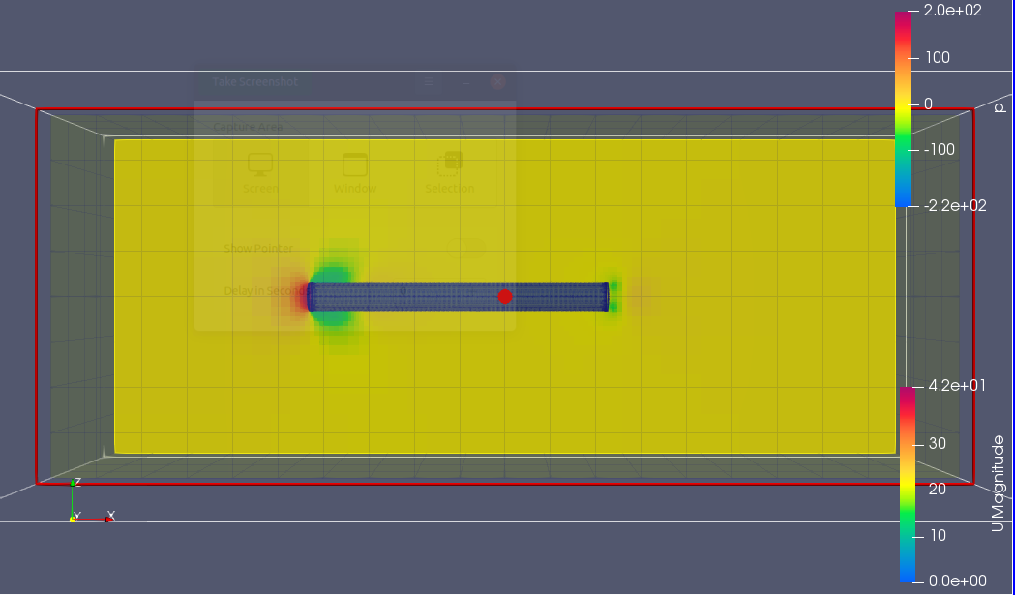
Pressure Field

Slide 22
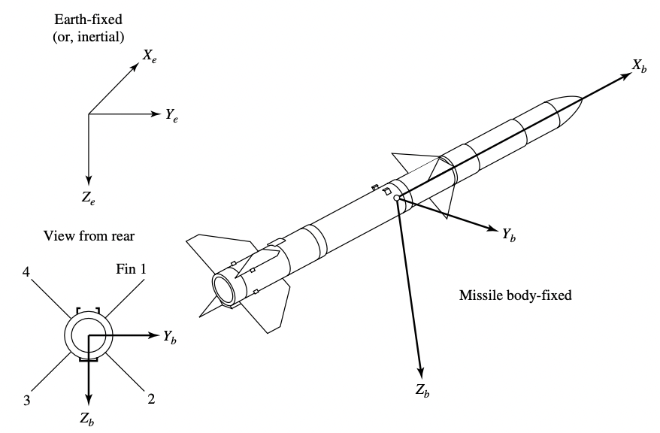
Dynamics

Slide 23
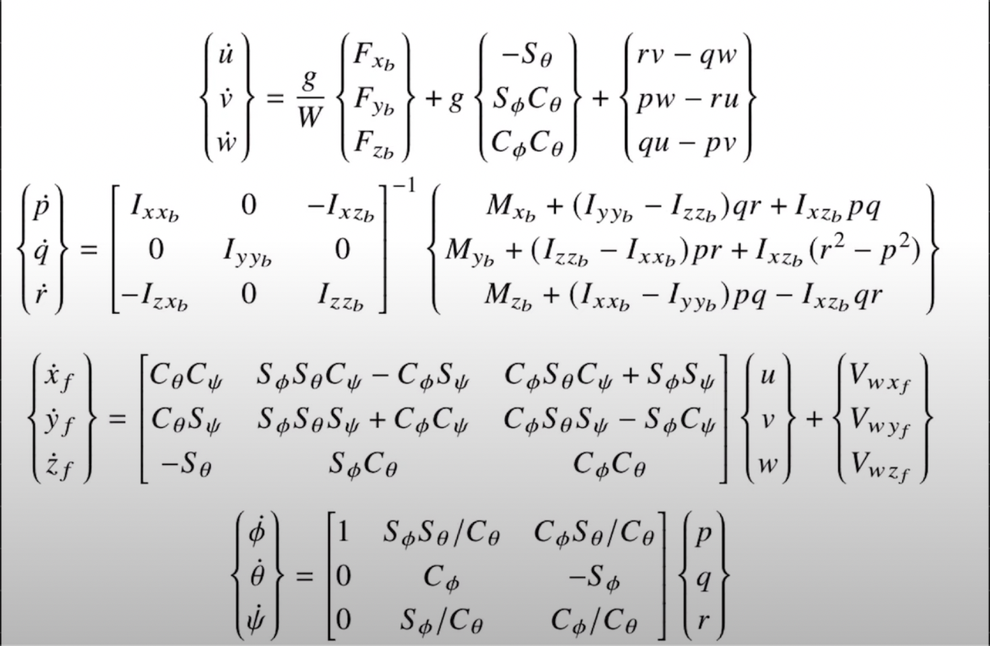
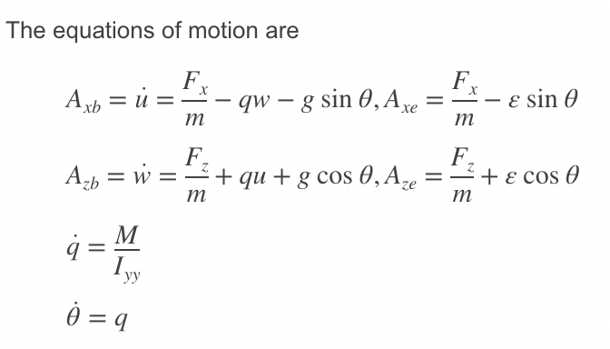
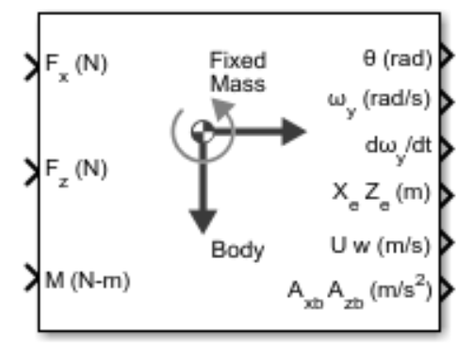
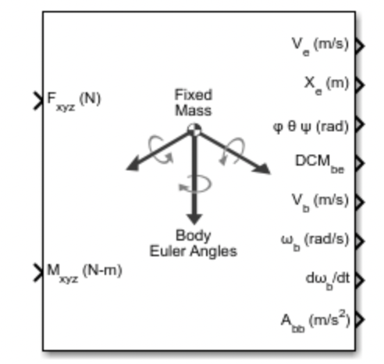
6DoF Equations
3DoF Equations
Assumptions
No roll
No motion in Y axis

Slide 24
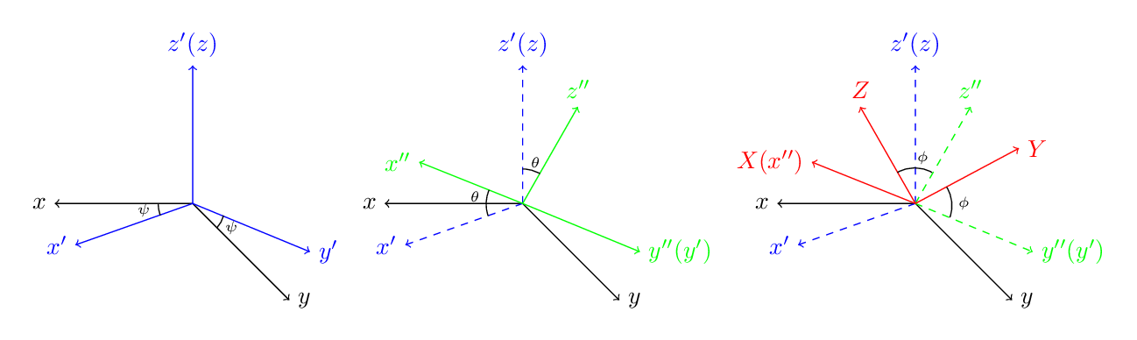
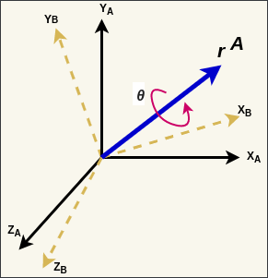
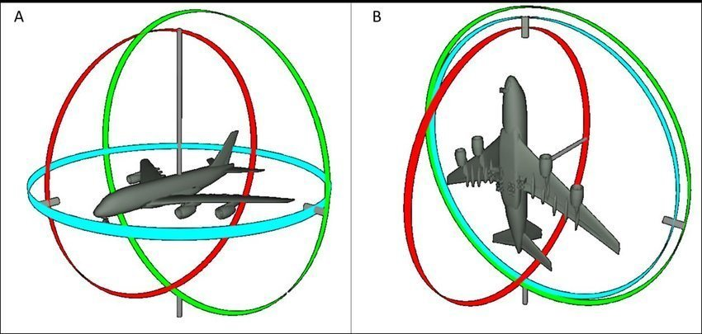
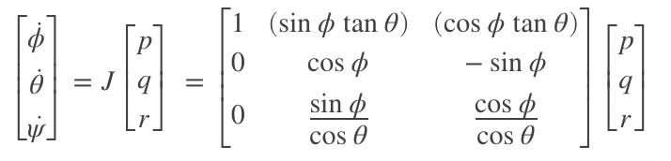
Euler Rotation Sequence-ZYX
Quaternions
Singularity in Euler Kinematical Equations
Gimbal Lock

Slide 25
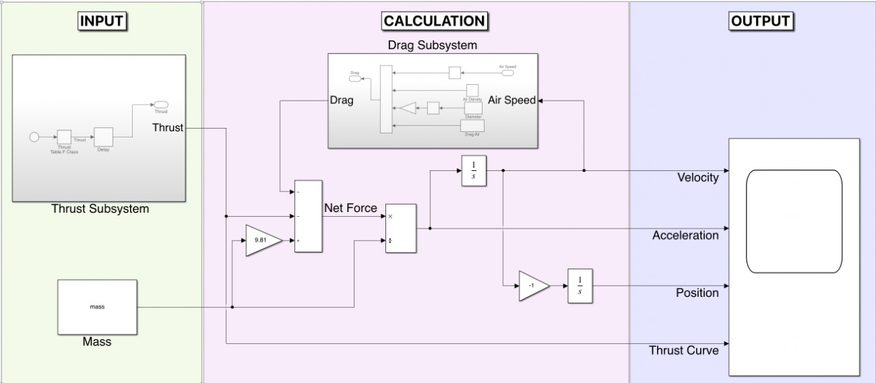
Basic Flight Simulation

Slide 26
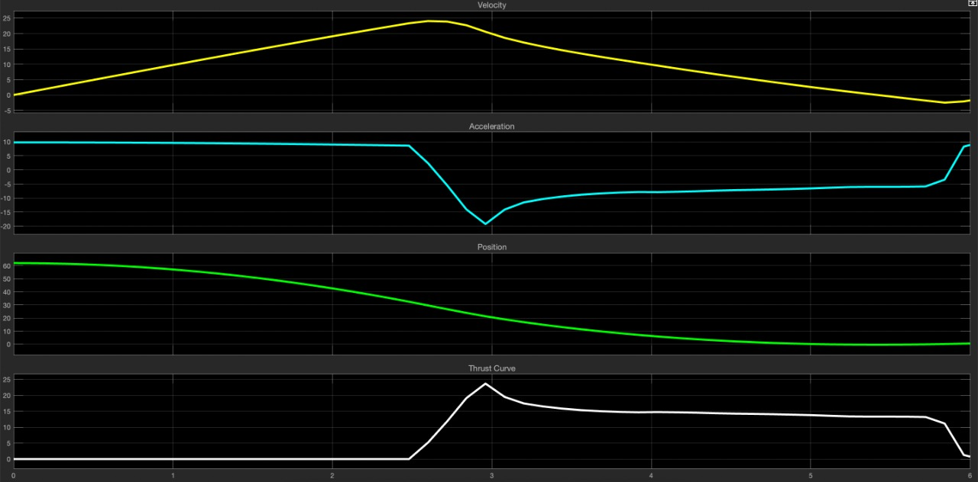
Basic Flight Simulation Results

Slide 27
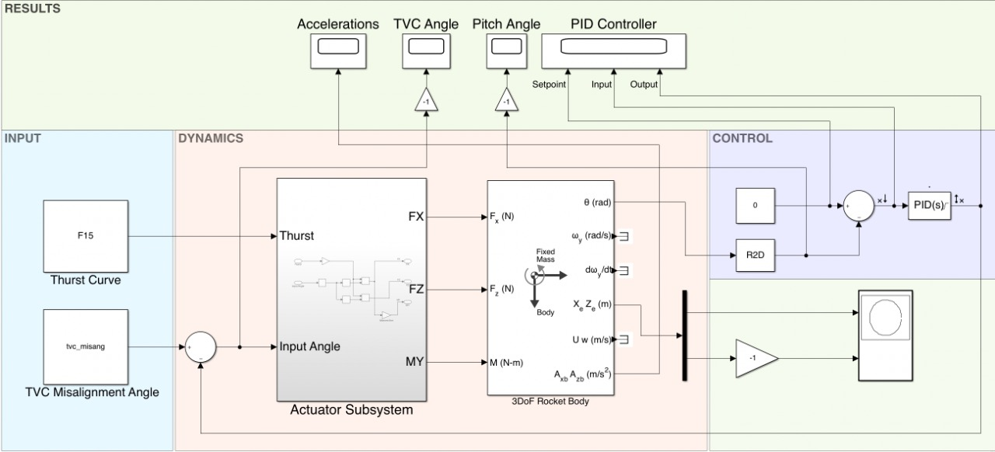
3DOF Flight Simulation

Slide 28
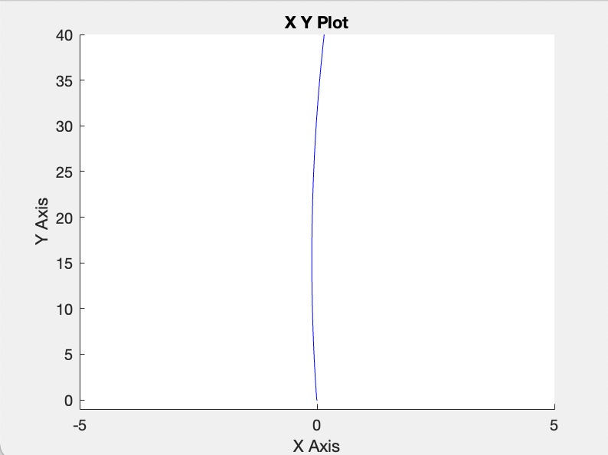
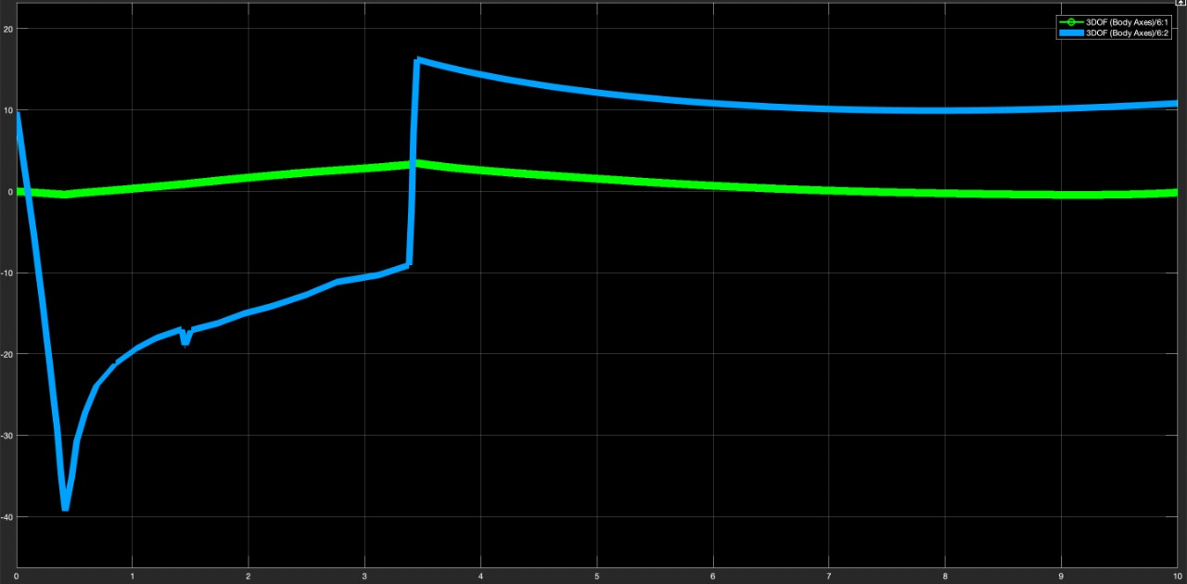
Trajectory and Acceleration Graph

Slide 29
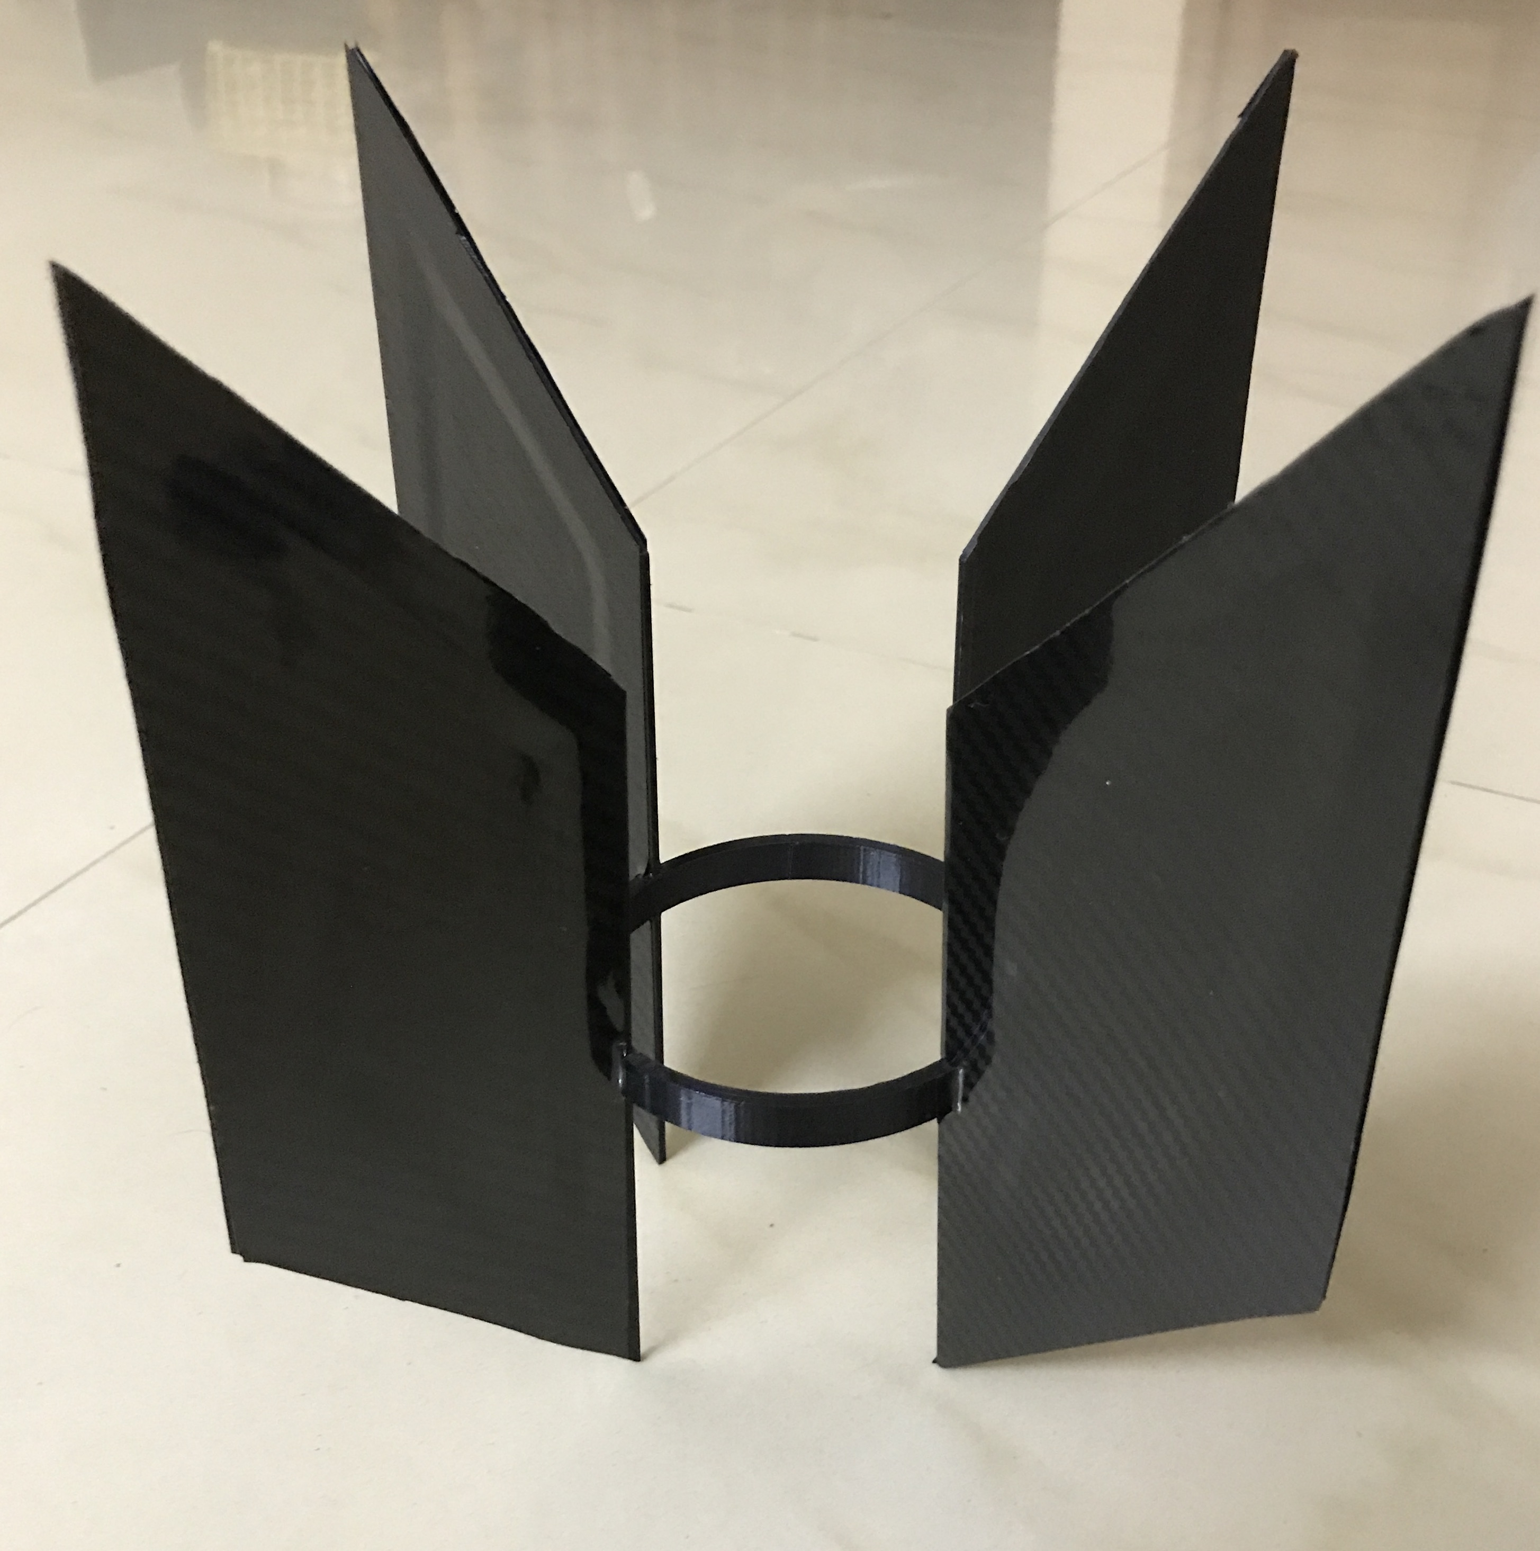
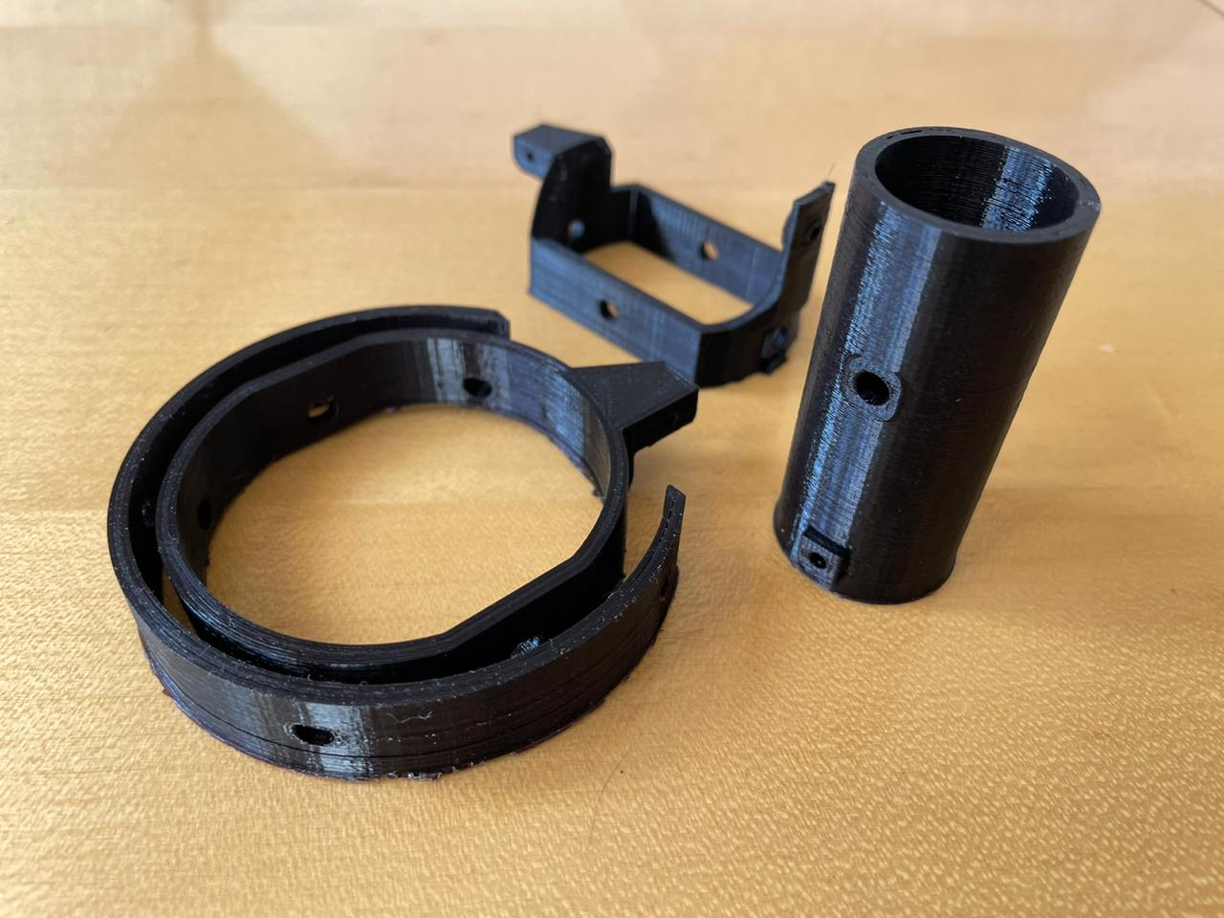
Manufactured Parts – Fins & TVC

Slide 30
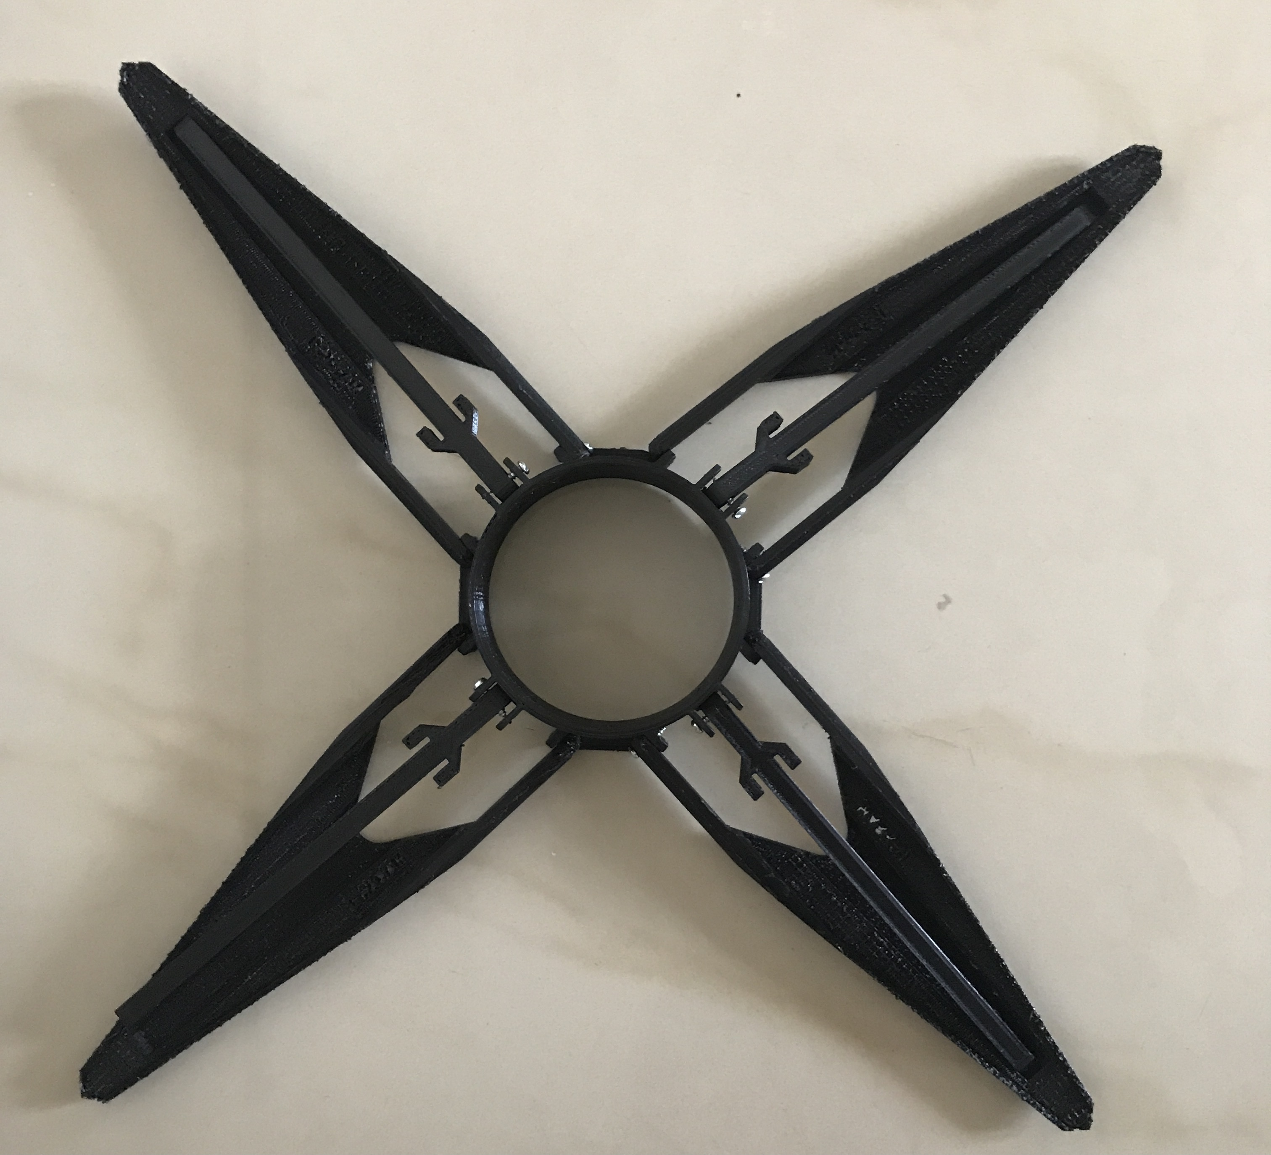
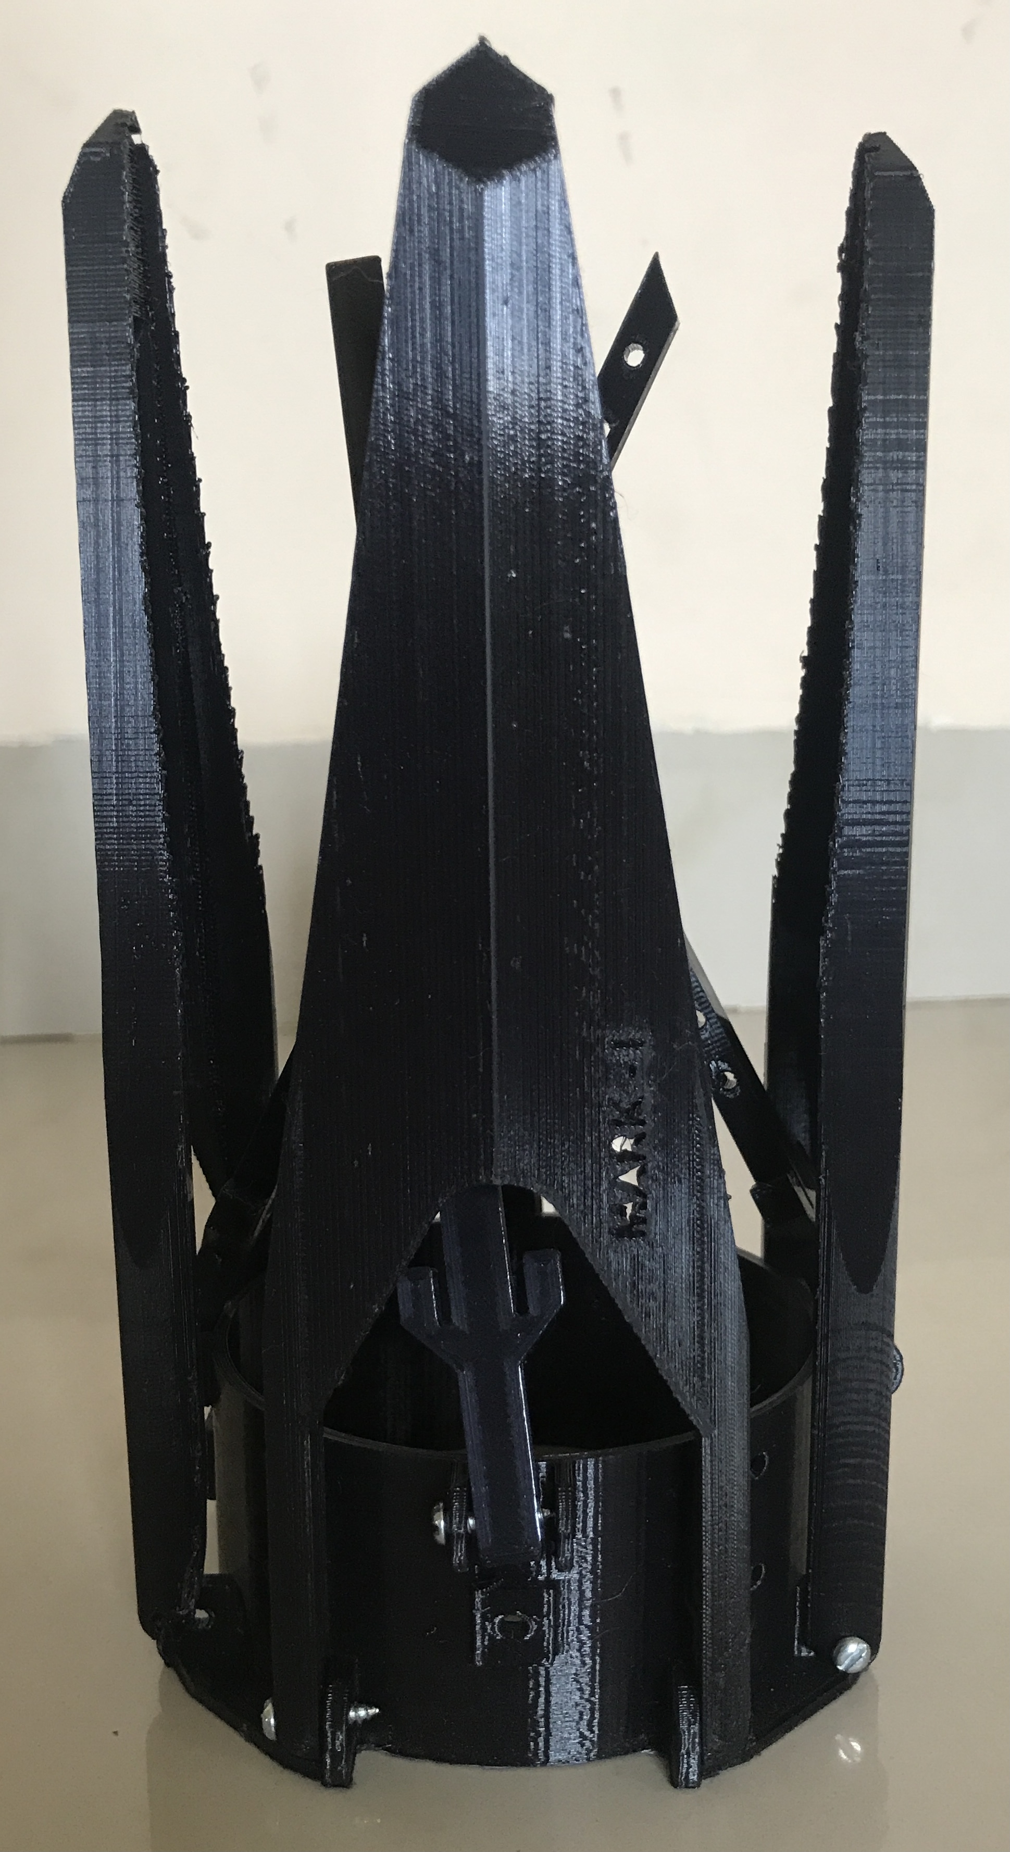
Manufactured Parts – Landing Legs

Slide 31
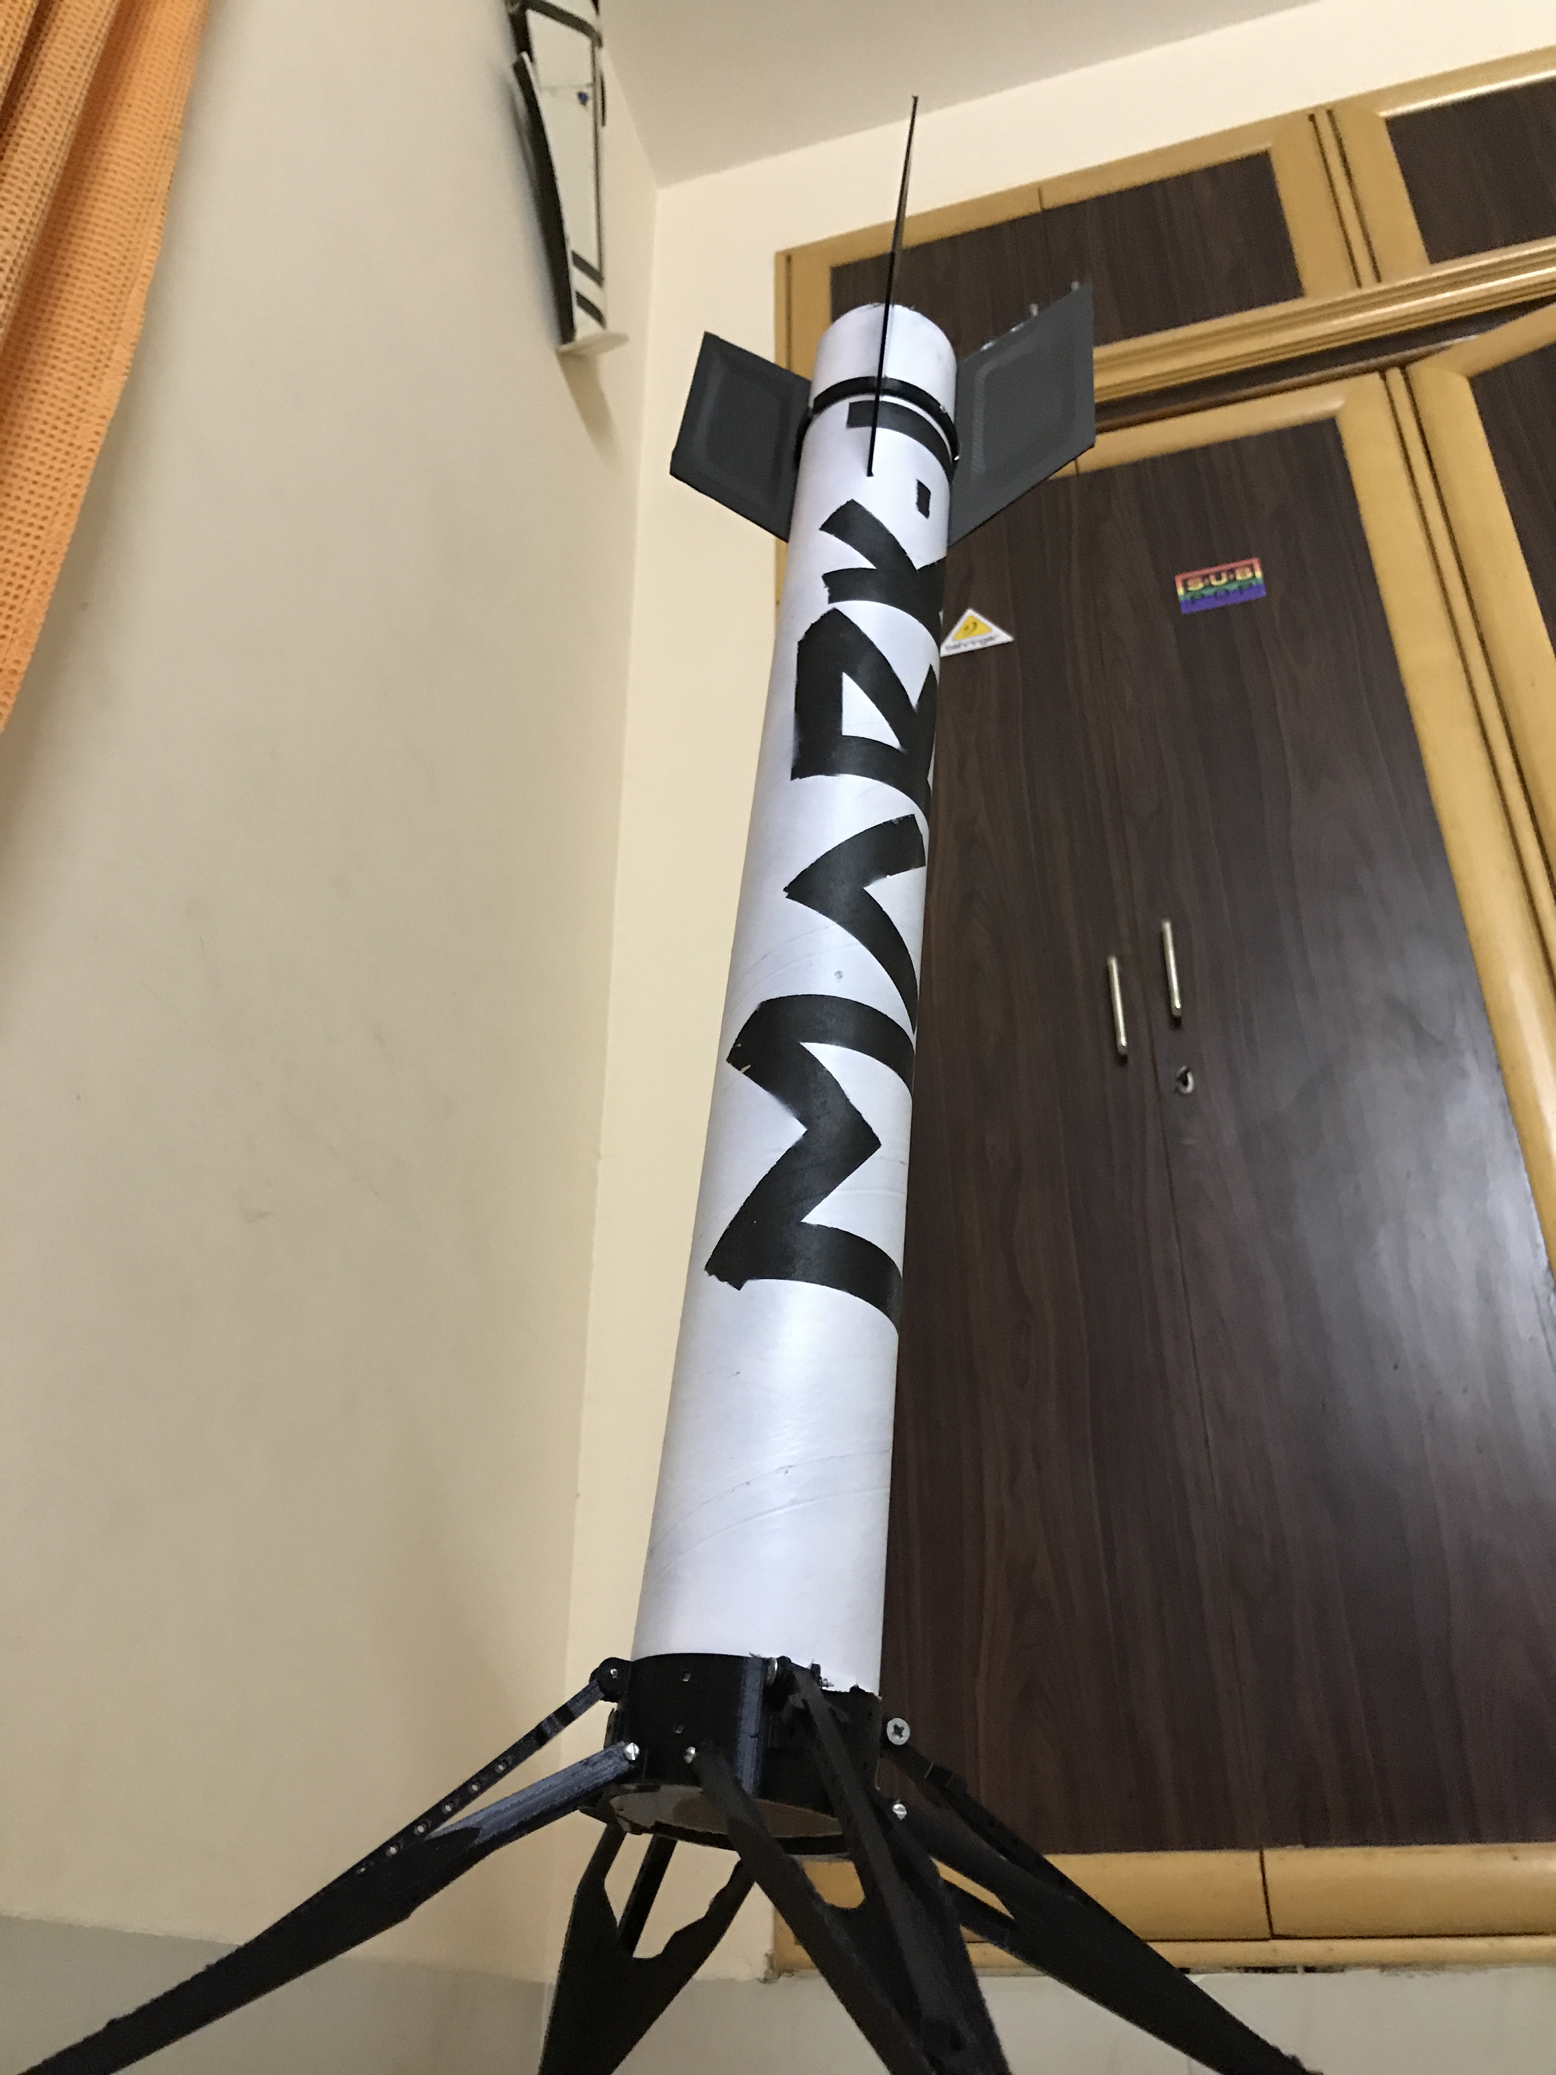
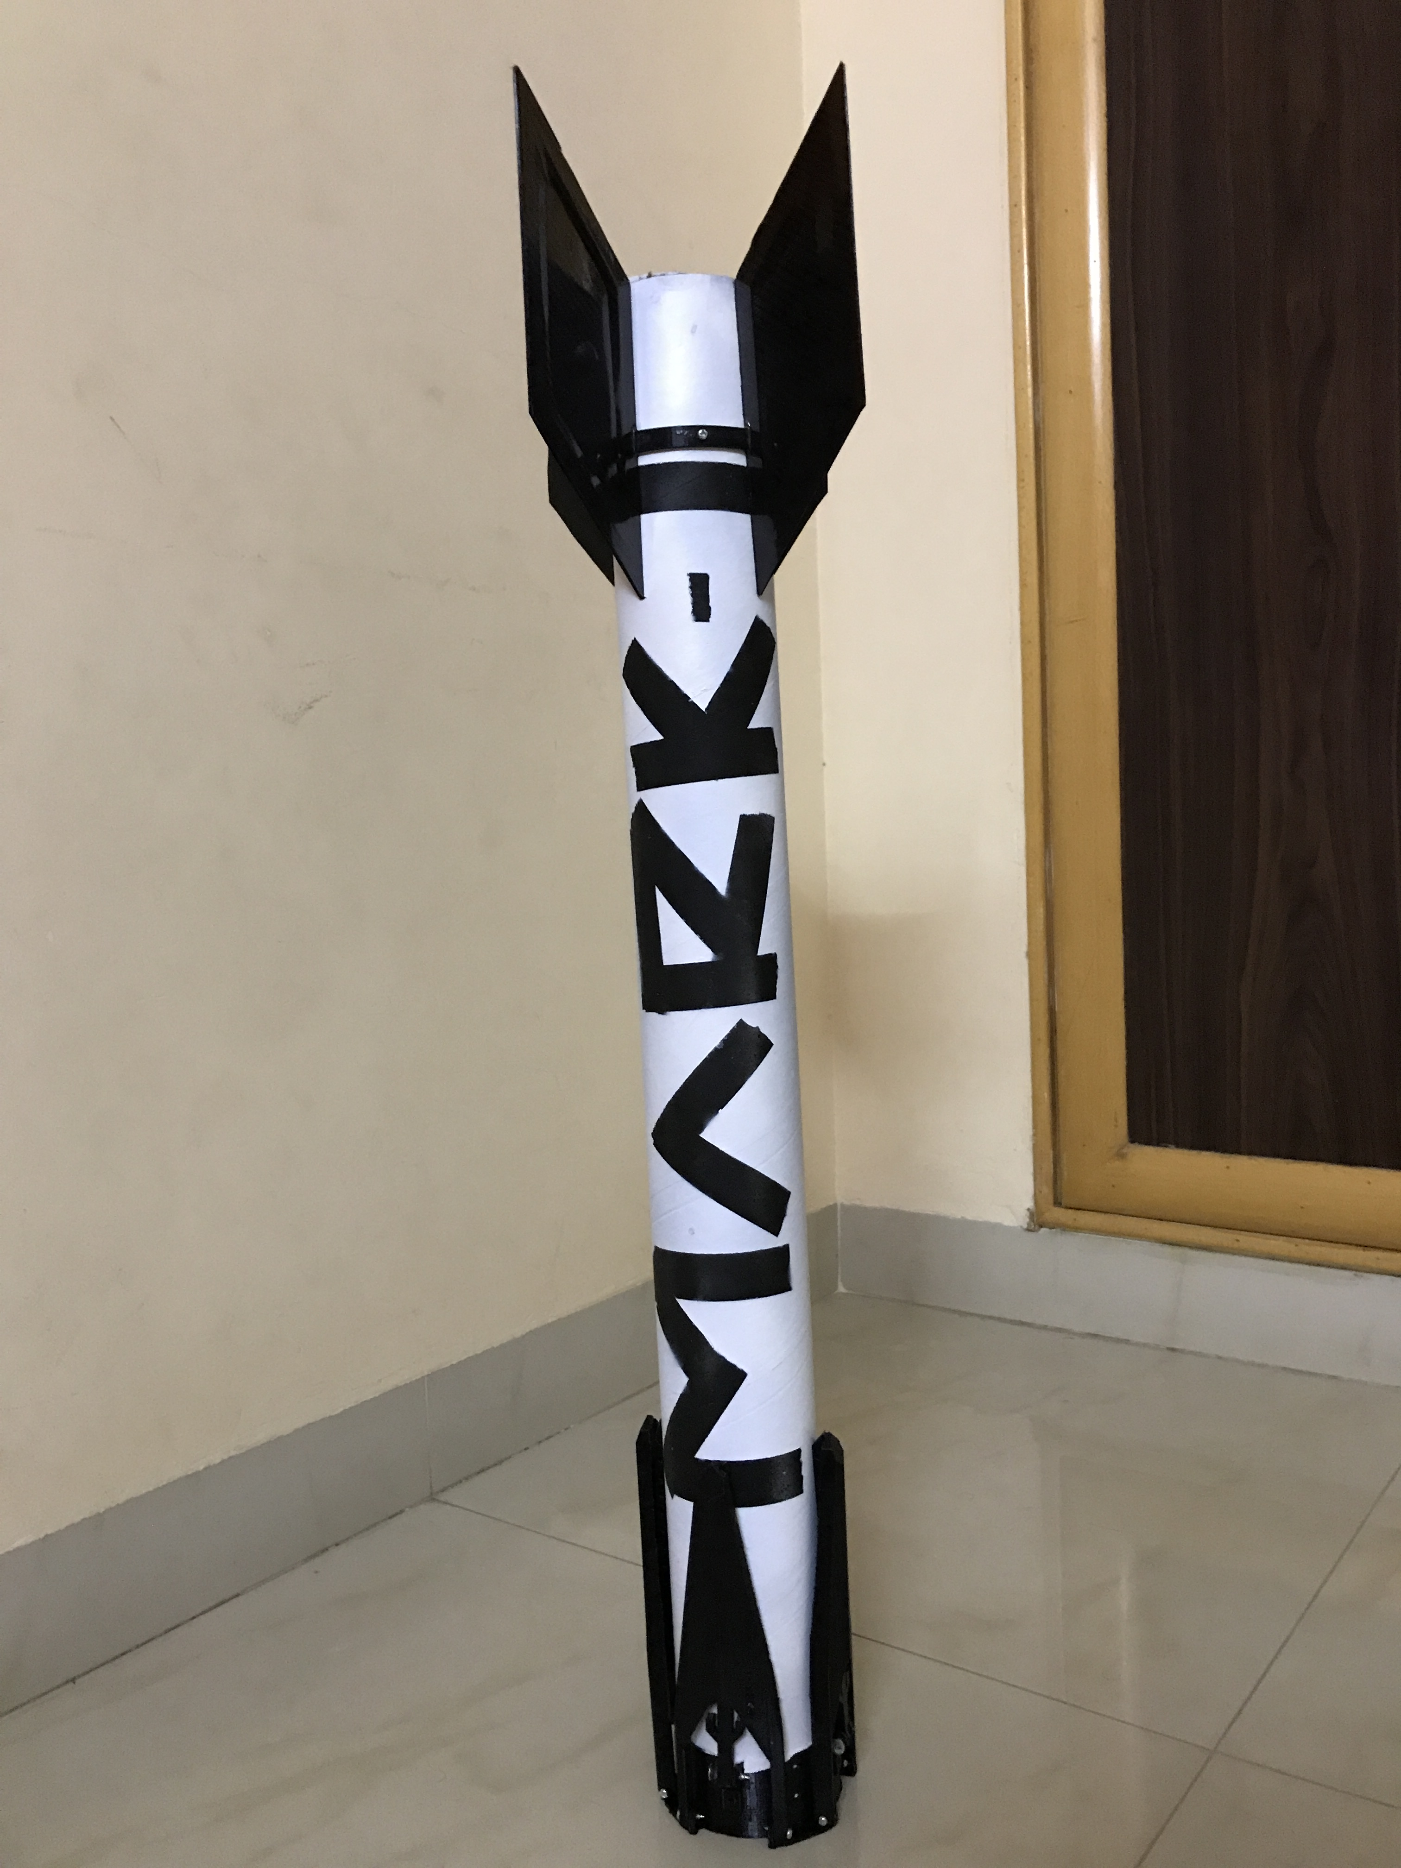
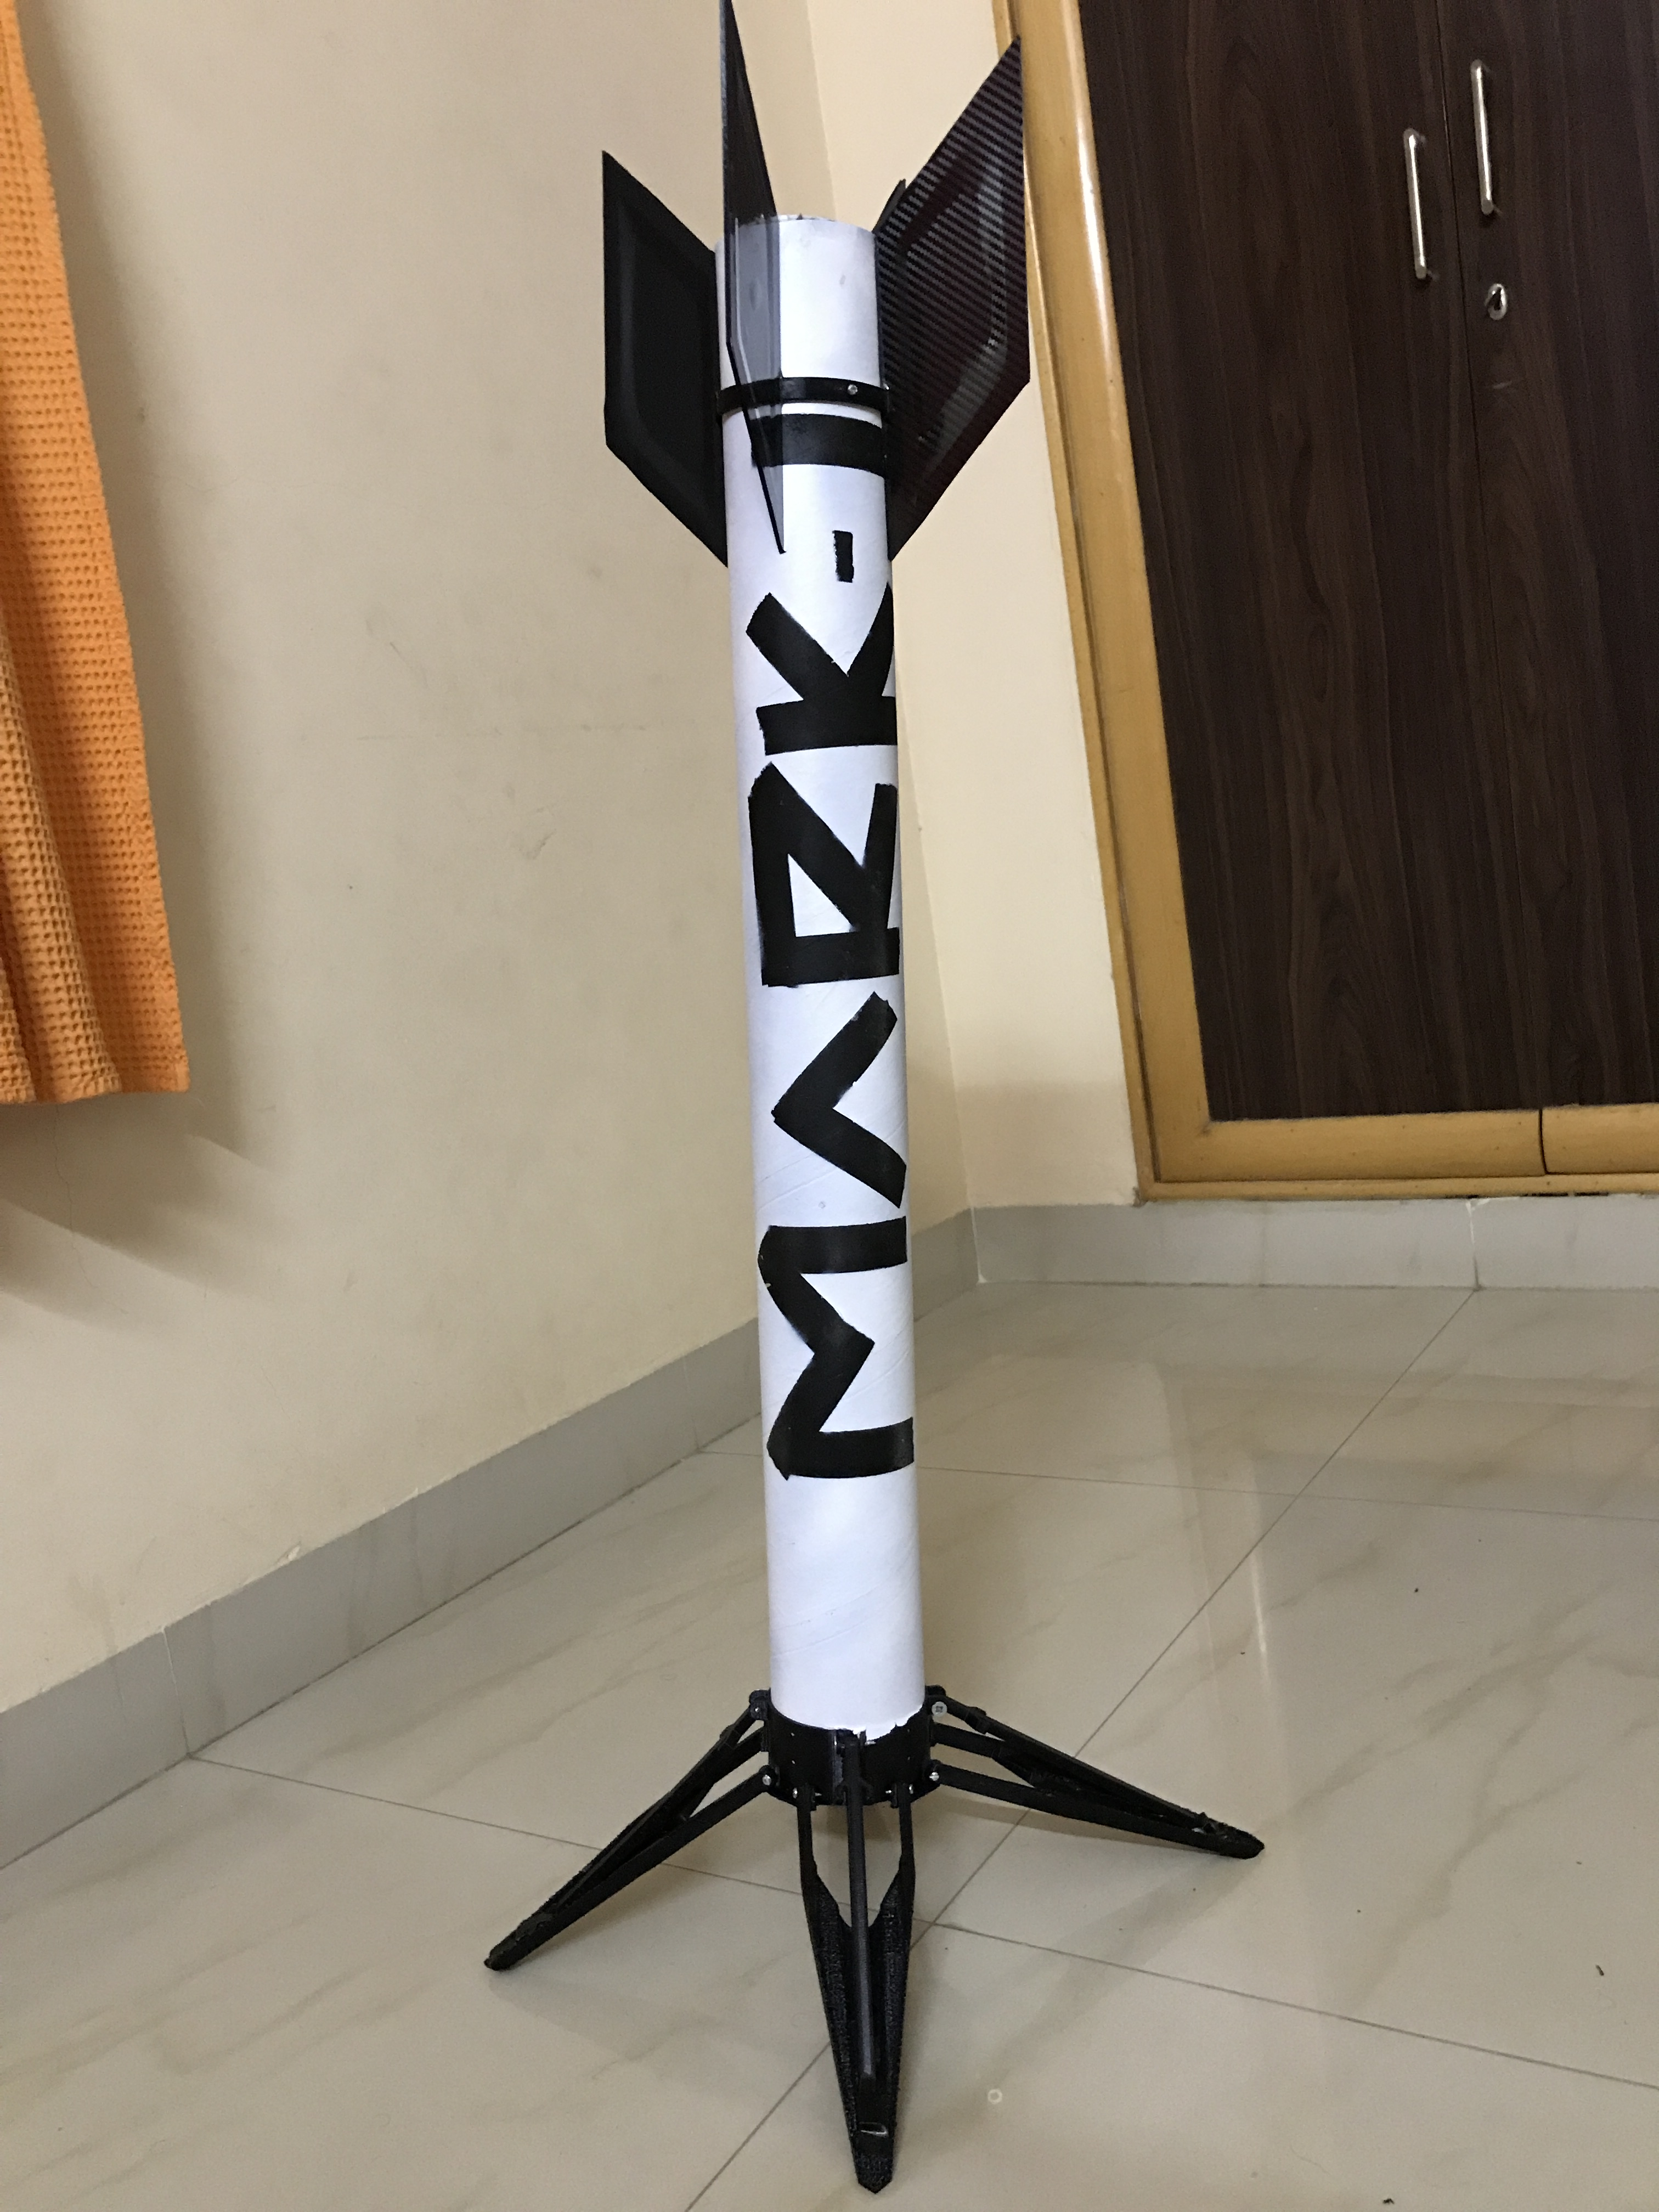

Slide 32
References
K. Foster, P. Dohn, N. LaPierre, T. Moquin, A. Dings, C. Cooper, J. Fennick and E. George, "Design and Integration of a High-Powered Model Rocket – I," AIAA Scitech. Forum, Jan, 2020, doi:10.2514/6.2020-0145.
Tewari, A. (2002). Modern Control Design With MATLAB and SIMULINK (1st ed.). Wiley.
Development of a Small Scale Reusable Launch Vehicle – Oregon JSHS Judging Presentation. (2020, March 22). [Video]. YouTube. https://www.youtube.com/watch?v=uGo4vNsuYWU
Thrust vector control. (n.d.). BPS.Space. Retrieved October 15, 2020, from https://bps.space/tvc
Small launcher market survey - Room: The Space Journal. (n.d.). Room, The Space Journal. Retrieved October 15, 2020, from https://room.eu.com/article/small-launcher-market-survey
Tewari, Ashish. Atmospheric and Space Flight Dynamics: Modeling and Simulation with MATLAB® and Simulink®. Germany, Birkhäuser Boston, 2007.
Stevens, Brian L., and Lewis, Frank L.. Aircraft Control and Simulation. United Kingdom, Wiley, 2003.
S.Niskanen,“Openrockettechnicaldocumentation,”DevelopmentofanOpenSourcemodelrocketsimulation software, pp. 11–13, 2013.

Slide 33
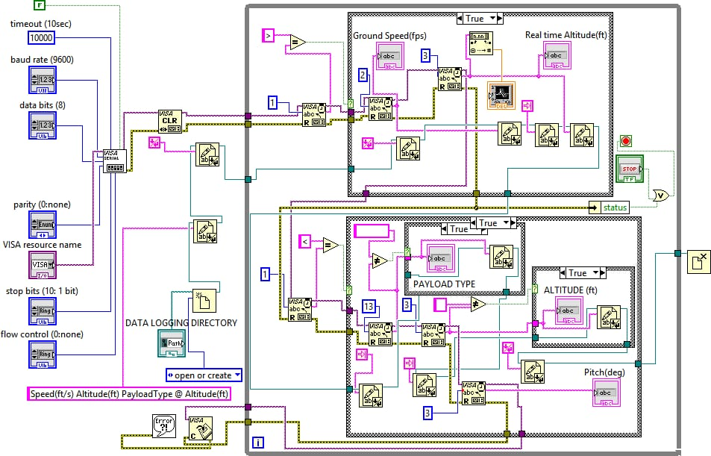
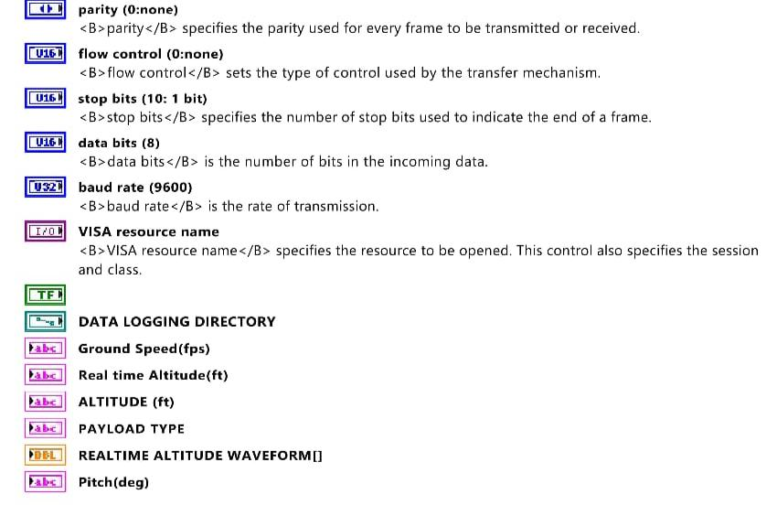
LabView (Additional Work)

Slide 34

Data
Acquisition
System
(GUI)
(Additional Work)

Slide 35


